Slide 1
TURNING IDEAS INTO REALITY: ENGINEERING A
BETTER WORLD
Zip Line
www.discovere.org
Notes:
Slide 1: As the pre-activity survey is distributed to students, introduce yourself and provide enough of an activity overview to gain students excitement.
Allow time for students to individually complete their pre-activity survey.
Divide group into teams of 3 to 4 students each.

Slide 2
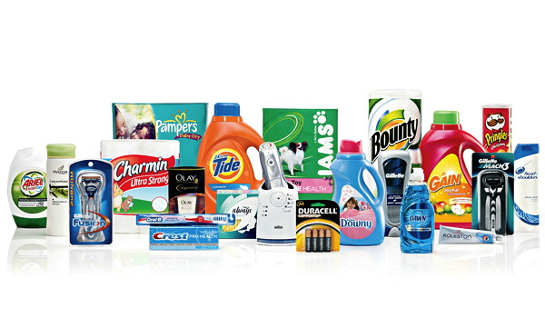
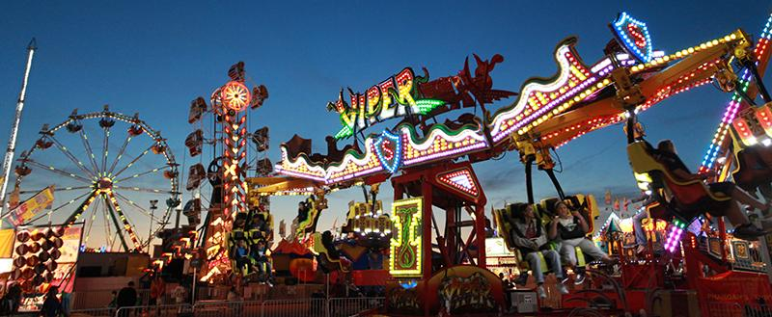
What does an engineer do?
Solve problems, and shape the future!
Create and design new “things” essential to health, happiness and safety:
Chemical things – food, medicine, shampoo, fuels…
Building things – bridges, skyscrapers, roads…
Technology things – iPods, Cameras, electronic gadgets…
Fun things – toys, roller coasters, sporting goods...
Important things – water systems, medical devices and tools…
Much, much more….the list is endless
images.businessweek.com
www.wistatefair.com
www.gettyimages.com
Notes:
Slides 2 and 3: Discuss engineering and what engineers do.

Slide 3
How do engineers do this?
Help others by solving all sorts of problems.
Use one of their most important tools: their own creativity.
Work in design teams.
Use cool tools such as computers, microscopes, testing machines, etc.
Communicate with lots of people about problems they need solved.
Share ideas and solutions with others through presentations and/or writing.
www.engineeringmessages.org
Notes:
Do all engineers do the same thing?
NO, NO, NO!!!!!
Many types of engineers
Chemical
Mechanical
Electrical
Civil
They do many different types of jobs
Design
Sale
Test
Much, much more!

Slide 4
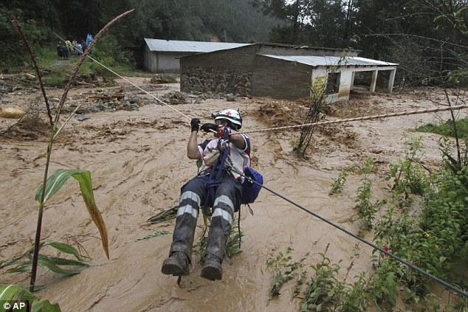
Today you will be a civil engineer – You will design, build and test a Zip line!
Engineering a Better World
There’s been a disaster! People can’t get to safety by cars, airplanes, or boats.
The only way to get people to safety is by zip line!
“Zip Line Rescues from Mexico Floods”
Watch the video
Notes:
Slide 4: Show “Zipline Rescues from Mexico Floods” video –
NOTE: Video must be ended abruptly at 1m14s.
http://www.nbcnews.com/video/nightly-news/53044233#53044233
*may have to copy and paste link into browser
detailed scenario. - A recent earthquake has collapsed a bridge, which was the only way out of an island. The islanders are running out of resources quickly, and need help. Your engineering team has concluded that the best and safest option is to transport the people off the island. The water’s current is currently too strong, making it an unsafe means of transportation. The only means of transportation remaining is the island’s famous zip line, which includes a section leading from the island to a neighboring city.

Slide 5
Engineering Design Problem
A recent earthquake has collapsed a bridge, which was the only way out of an island. The islanders are running out of resources quickly, and need help.
Your engineering team has concluded that the best, and safest, option is to transport the people off the island. The water’s current is currently too strong, making it an unsafe means of transportation.
The only means of transportation remaining is the island’s famous zip line, which includes a section leading from the island to a neighboring city.
www.engineeringmessages.org
Notes:
Slide 5: Present the real-world engineering design problem (scenario).

Slide 6
Engineering Design Challenge
Your team’s challenge is to design and build a cradle that will safely transport one islander at a time across the zip line from the island to the neighboring city.
www.engineeringmessages.org
Notes:
Slide 6: Introduce the Engineering Design Challenge.

Slide 7
Design Goals
Your team of engineers will design cradle that holds and transports islanders along a zip line and off the island.
Your design must cradle and transport one Lego person at a time to safety.
Only materials supplied to your may be used.
Hold your design at the top of the zip line, force its potential energy to transform to kinetic energy by giving it a push.
You may not help your design complete its movement across the zip line.
Have fun!!
Notes:
Slide 7: Discuss Engineering Design Goals.

Slide 8
Materials
Notes:
Slide 8: Introduce resources (materials) available to each team.
You will have: straws, masking tape, string/yarn, toothpicks, duct tape, paper clips, pipe cleaners, wooden craft sticks, ribbon, rubber bands, and cups.
If constraining material quantities – use these amounts for each group
Straws, 5 total
Masking tape, 3 in
String/yarn, 1 ft
Tooth picks, 8 total
Duct tape, 2 inches
Paperclips, 3 total
Pipe cleaners, 2 each
Wooden craft sticks, 4 each
Ribbon, 5 inches
Rubber bands, 5 total
Cups, 1 each

Slide 9
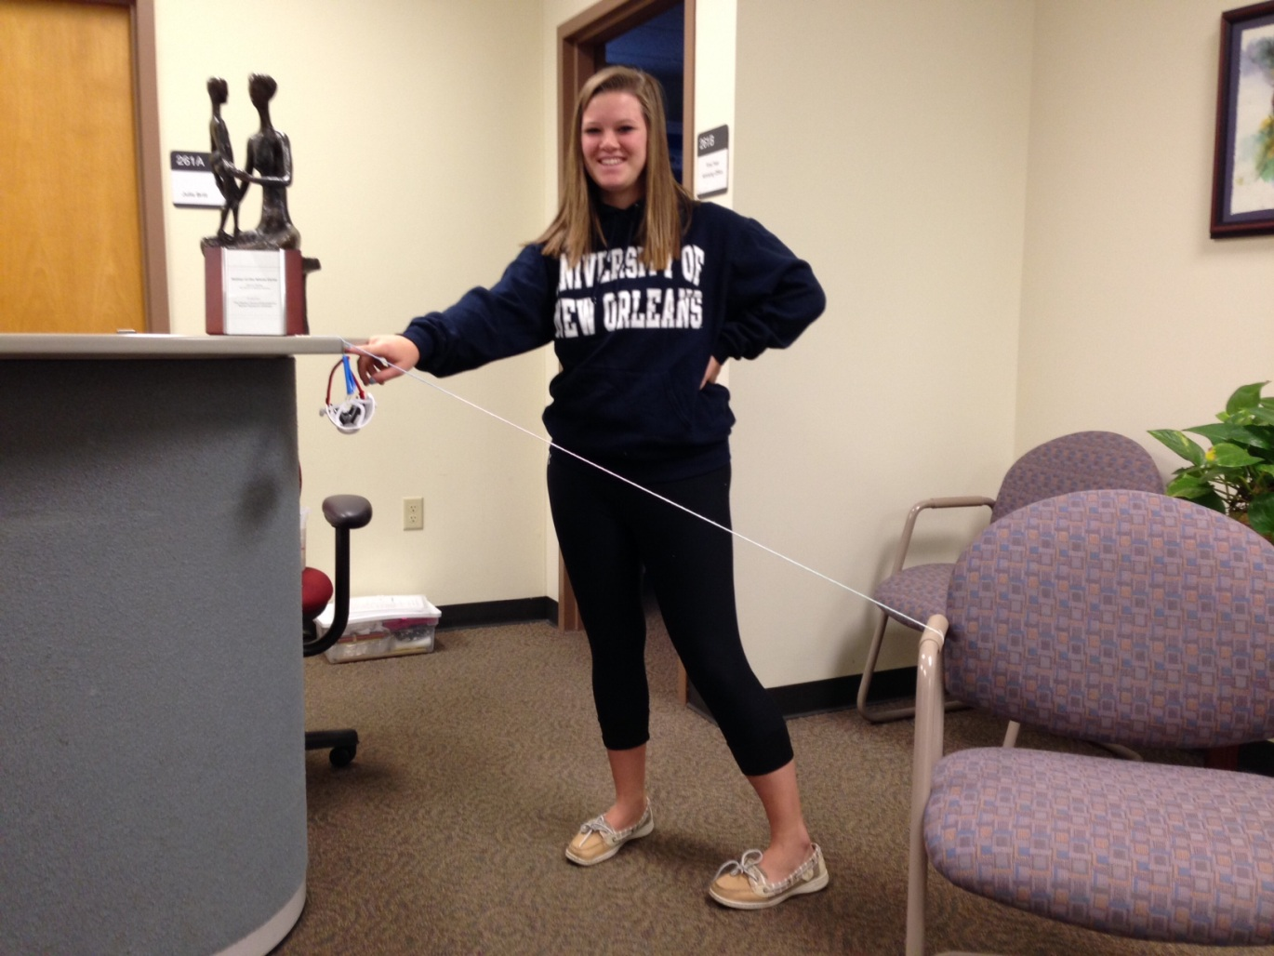
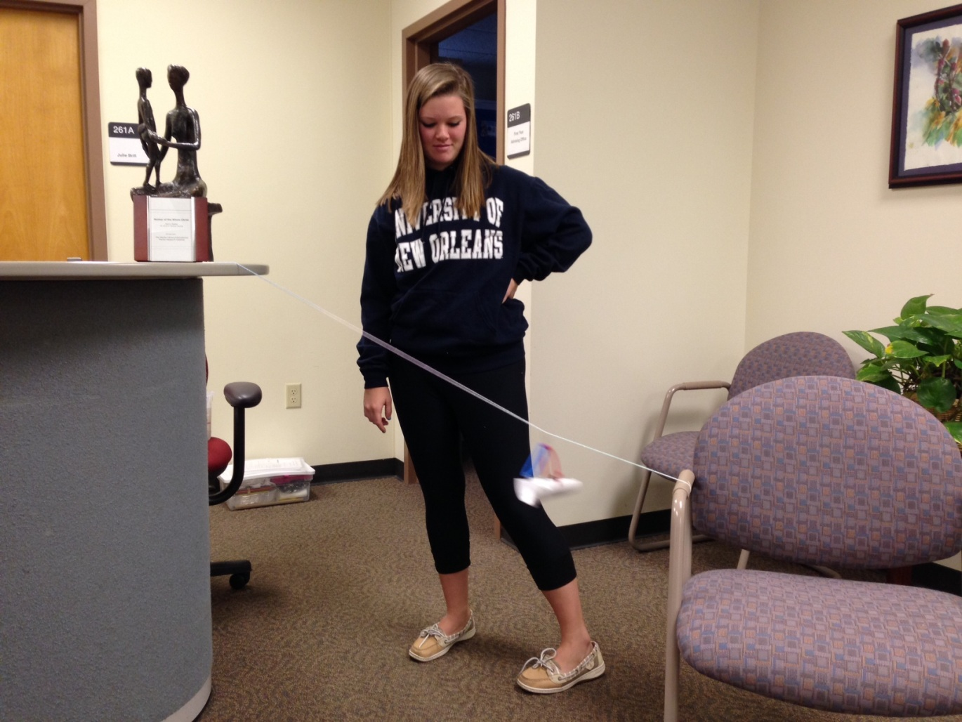
Design Testing
DAYTON
DAYTON
Notes:
Slide 9: Explain prototype-testing procedures.

Slide 10
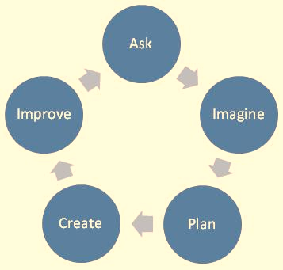
Engineering Design Process
ASK: What is the problem? How have others approached it? What are your constraints?
IMAGINE: What are some solutions? Brainstorm ideas. Choose the best one.
PLAN: Draw a diagram. Make lists of materials you will need.
CREATE: Follow your plan and create something. Test it out!
IMPROVE: What works? What doesn't? What could work better? Modify your designs to make it better. Test it out!
www.teachengineering.org
Notes:
Slide 10: Introduce the Engineering Design Process. Explain that engineers use it as a tool to help them more effectively solve problems.

Slide 11
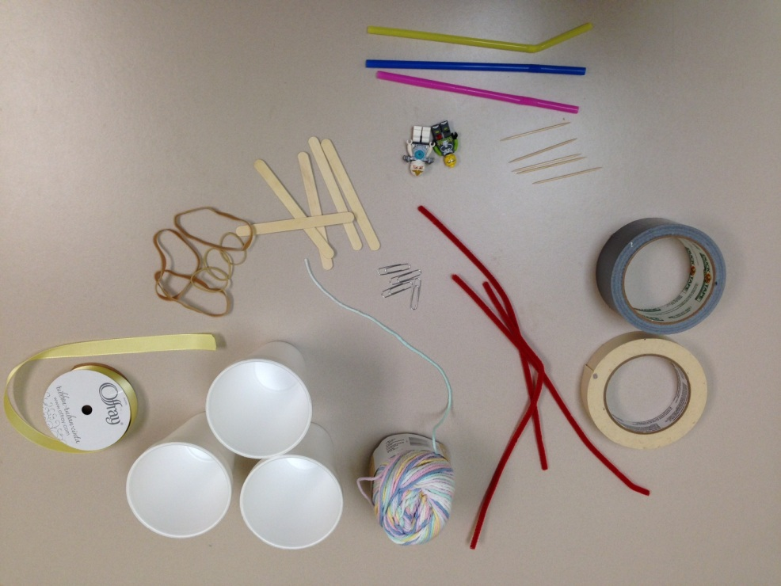
Engineering Design Process
Imagine (10 min.)
INDIVIDUALLY: observe available materials, and brainstorm and write design ideas (5 min.)
TEAM: share individual ideas (5 min.)
Plan (5 min.)
Choose and sketch a team design plan
Create (10 min.)
Gather materials
Construct your team design plan
Improve and Test (10 min.)
Notes:
Slide 11: Explain how teams will use the engineering design process as they complete the challenge:
Imagine (10 min.)
INDIVIDUALLY: observe available materials, and brainstorm and write design ideas (5 min.)
TEAM: share individual ideas (5 min.)
Plan (5 min.)
Choose and sketch a team design plan
Create (10 min.)
Gather materials
Construct your team design plan
Improve and Test (10 min.)
Teams decide on and make any last minute improvements before testing
Each team tests their prototype while other teams observe
Start with only one push from the top of the zip line
Ensure the zip line has a steep slope
Design must make it to the bottom of the zip line, holding Lego people throughout
Don’t let the students get their materials until they have their designs, adjust times and process as needed
Explain how groups will work.
*At least groups of two - no one works alone.
*Groups must work together in creating ideas and design.
Create and improve
May need multiple test lines set up depending on group size
Final test
May need multiple test lines set up depending on group size
Have each group showcase how their design works
Probing questions for discussion –
Does the slope if the zipline make a difference on how the design works?
Friction – how does the friction play a role in this design?

Slide 12
Design Reflection
What went well? Not so well? Why?
What modifications would you make if we had time to complete the design challenge again?
Did other designs give you ideas for ways to improve your design?
Do you think that changing the slope (angle) of the zip line would make a difference?
How did transformations between potential energy and kinetic energy force your design to move along the zip line?
What role did friction play on the safety and speed of your design as people were transported along the zip line?
www.engineeringmessages.org
Notes:
Slide 12: Facilitate a whole group reflection on final prototype design and testing results by asking questions such as the following.
What do you like best about your design?
What do you like least about your design?
What aspects of other team designs stood out to you, and/or gave you ideas for improving your own team’s design?
What modifications would you make if we had time to complete the design challenge again?
Do you think that changing the slope (angle) of the zip line would make a difference?
How did transformations between potential energy and kinetic energy force your design to move along the zip line?
What role did friction play on the safety and speed of your design as people were transported along the zip line?

Slide 13
Wrap Up
What ideas do you have for engineering a better world?
How can you turn ideas into reality?
www.engineeringmessages.org
Notes:
Slide 13: Conclude by discussing the following questions as post-activity surveys are distributed.
What ideas do you have for engineering a better world?
How can you turn ideas into reality?

Slide 14
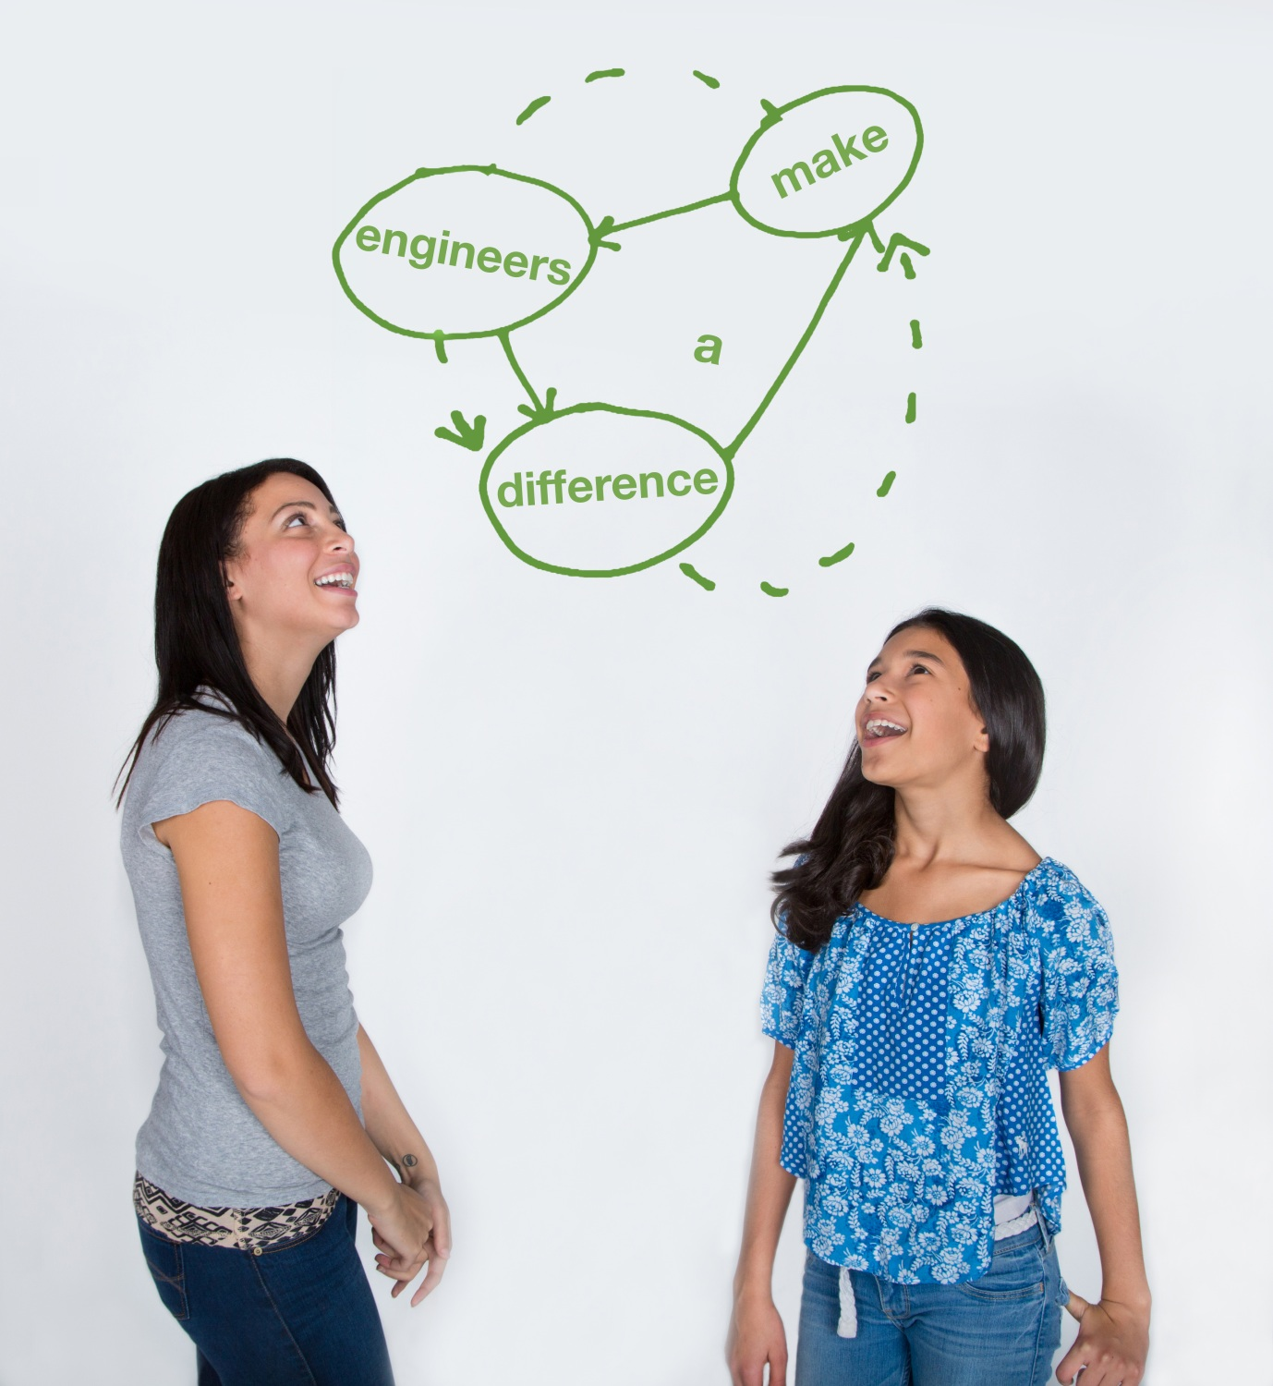
This material is based upon work supported by the National Science Foundation under Grant No. EEC – 1009607 and through EiF grant 14.06
References:
This activity has been adapted from the Rescue Rover and Conveyor Belt activities provided from tryengineering.com.
Conveyor Engineering - http://www.tryengineering.org/lesson-plans/conveyor-engineering
Rescue Rover - http://www.tryengineering.org/lesson-plans/rescue-rover
Zipline rescues from Mexico floods. NBCNews.com. NBC nightly news, 18 Sept 2013. Retrieved from: http://www.nbcnews.com/video/nightly-news/53044233#53044233.
Thank you for the funding through the Engineering Information Foundation
NBC Nightly News
Smooth Operator Presentation by Margaret Pinnell, PhD.
www.discovere.org
Notes:
Slide 14: Allow time for students to complete their post-activity survey.

