Slide 1
21 Elephants and Still Standing
“Using Engineering Design to Increase Literacy and STEM Interest Among Third Graders”
This material is based upon work supported by the Engineering Science Foundation of Dayton under Grant No. AD2018-0001 and through a 2017-18 grant from the Marianist Foundation.

Slide 2
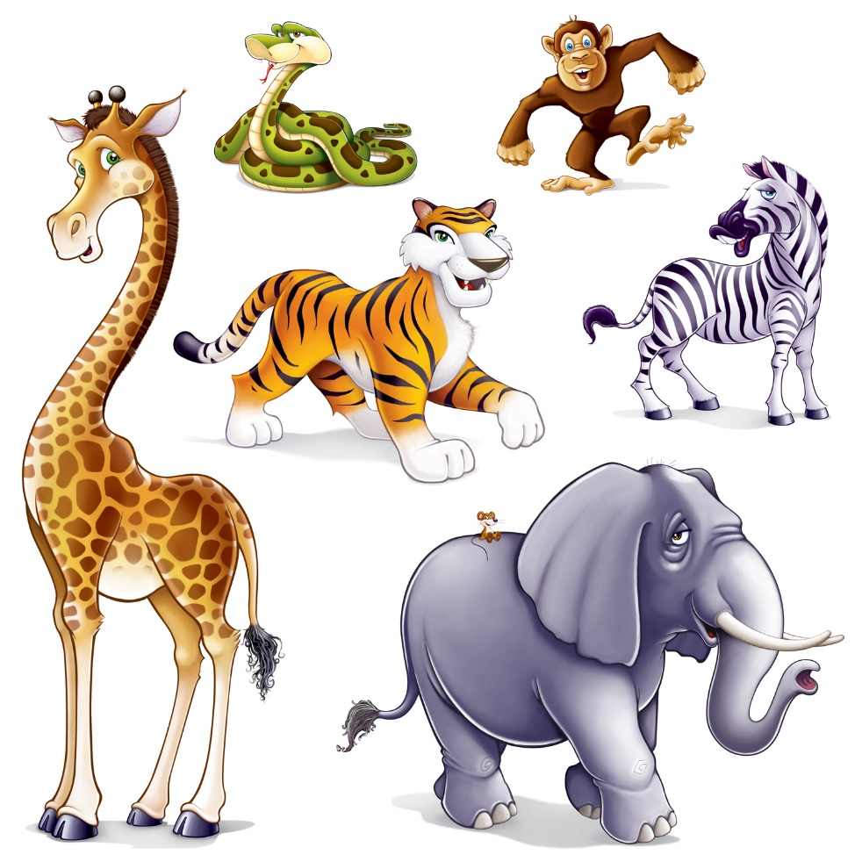
Day 1: Journal Entry
Describe your favorite animal.
What does the animal look like?
How big or small is the animal?
Where does the animal live?
What does the animal like to eat?
What color is the animal?
Have you seen the animal before?
www.clipartsuggest.com

Slide 3
Engineering Design Problem and Challenge
Problem:
Phineas T. Barnum marched his elephants across the Brooklyn Bridge to prove the bridge was safe. Since the bridge held for 21 elephants, everyone now wants to take the bridge. The city needs to build another bridge to hold all the people who want to cross the river. The river is wider where the new bridge will go, so it needs to be longer than the first bridge.
Challenge:
Your team’s challenge is to design and build a bridge according to directions and then make the bridge longer to cross a wider section of the river.
www.goodreads.com

Slide 4
Design Goals
Design a bridge using K’Nex Education - Introduction to Structures: Bridges.
The bridge must be 8 panels long.
The bridge should hold the most weight possible.

Slide 5
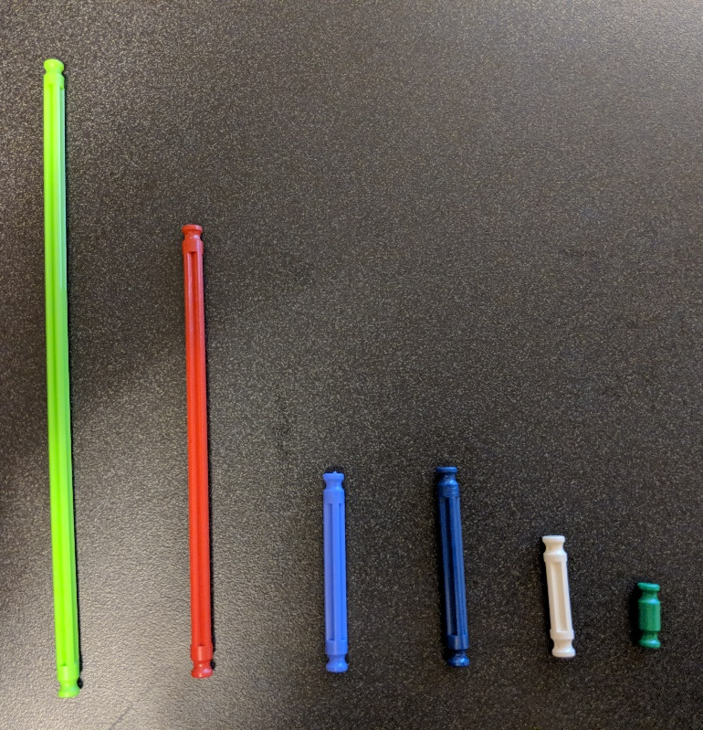
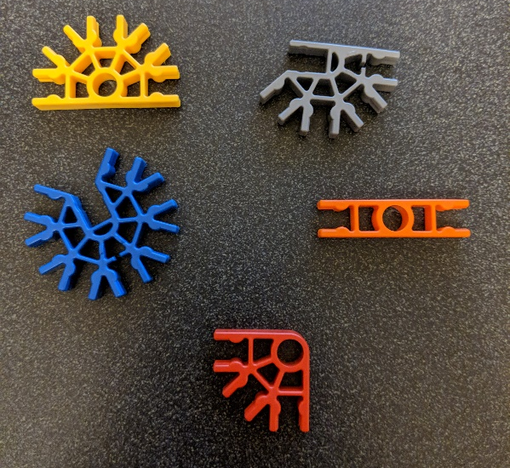
Resources
K’Nex Education - Introduction to Structures: Bridge Pieces and Instructions
Panels
Rods
Connectors

Slide 6
Design Testing Procedures
Prepare
Move two tables about 18 inches apart and place the bridge on top of the tables to connect them.
Make sure nothing is underneath the bridge or tables.
Test
Add testing masses to the top of the bridge until it collapses or is no longer safe to use.
Record how much mass the bridge held.
Reflect
Think about what part of the bridge broke.
Discuss how the bridge can be improved.
Redesign
Use what you learned from testing to improve the bridge.
Retest to see if the improvements worked.

Slide 7
The Engineering Design Process
ASK: What is the problem? How have others approached it? What are your constraints?
IMAGINE: What are some solutions? Brainstorm ideas. Choose the best one.
PLAN: Draw a diagram. Make lists of materials you will need.
CREATE: Follow your plan and create something. Test it out!
IMPROVE: What works? What doesn't? What could work better? Modify your designs to make it better. Test it out!
www.teachengineering.org
Ask
Improve
Imagine
Create
Plan

Slide 8
Ask
Ask questions
Who usually works on bridges?
What bridges already exist?
Which bridges are strongest and best for going over a river?
Why do we need bridges?
www.clipartpost.com
www.clipartix.com

Slide 9
River Challenge
Problem:
You have just arrived at a river. You want to cross the river, but there is no bridge close by. You find large rocks nearby and will work with your team to try to get everyone across the river without getting wet.
Rules:
If anyone on the team steps in the river, everyone starts over.
You can only step on the rocks.
Only one rock can be moved at a time.
You cannot slide the rocks in the river.
You can only hold a maximum of 2 rocks in your hands at one time.

Slide 10
Day 2: Journal Prompt
Why do we need bridges?
What problems do they solve?
Write a story about a time a bridge solved a problem.

Slide 11
Engineering Design Process
ASK: What is the problem? How have others approached it? What are your constraints?
IMAGINE: What are some solutions? Brainstorm ideas. Choose the best one.
PLAN: Draw a diagram. Make lists of materials you will need.
CREATE: Follow your plan and create something. Test it out!
IMPROVE: What works? What doesn't? What could work better? Modify your designs to make it better. Test it out!
www.teachengineering.org
Ask
Improve
Imagine
Create
Plan

Slide 12
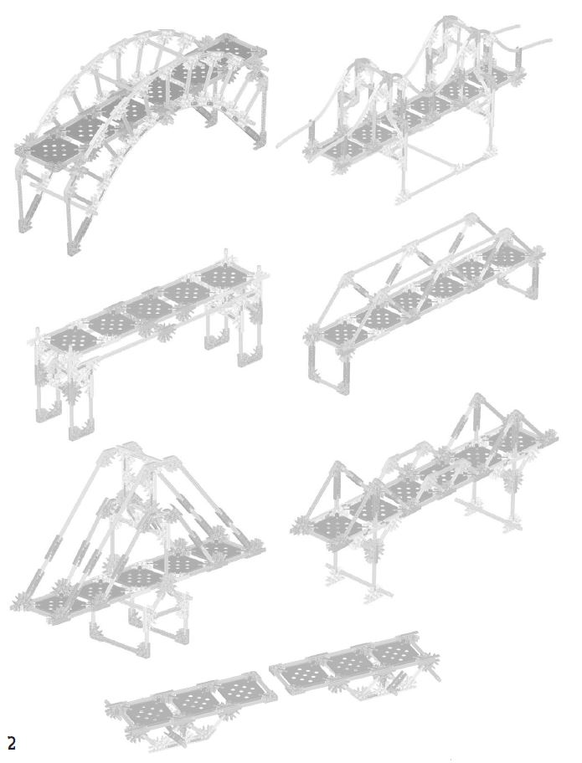
Ask: What types of bridges already exist?
Let’s learn more about bridges:
Follow directions and build one of these K’Nex bridges with a partner. Let’s try to have each group build a different type of bridge.

Slide 13
Bridge Design Options
Bridge A
Bridge B
Bridge C
Bridge D

Slide 14
Design Testing Procedures: Prepare, Test, Reflect and Redesign
Prepare
Move two tables about 18 inches apart and place the bridge on top of the tables to connect them.
Make sure nothing is underneath the bridge or tables.
Test
Add testing masses to the top of the bridge until it collapses or is no longer safe to use.
Record how much mass the bridge held.
Reflect
Think about what part of the bridge broke.
Discuss how the bridge can be improved.
Redesign
Use what you learned from testing to improve the bridge.
Retest to see if the improvements worked.

Slide 15
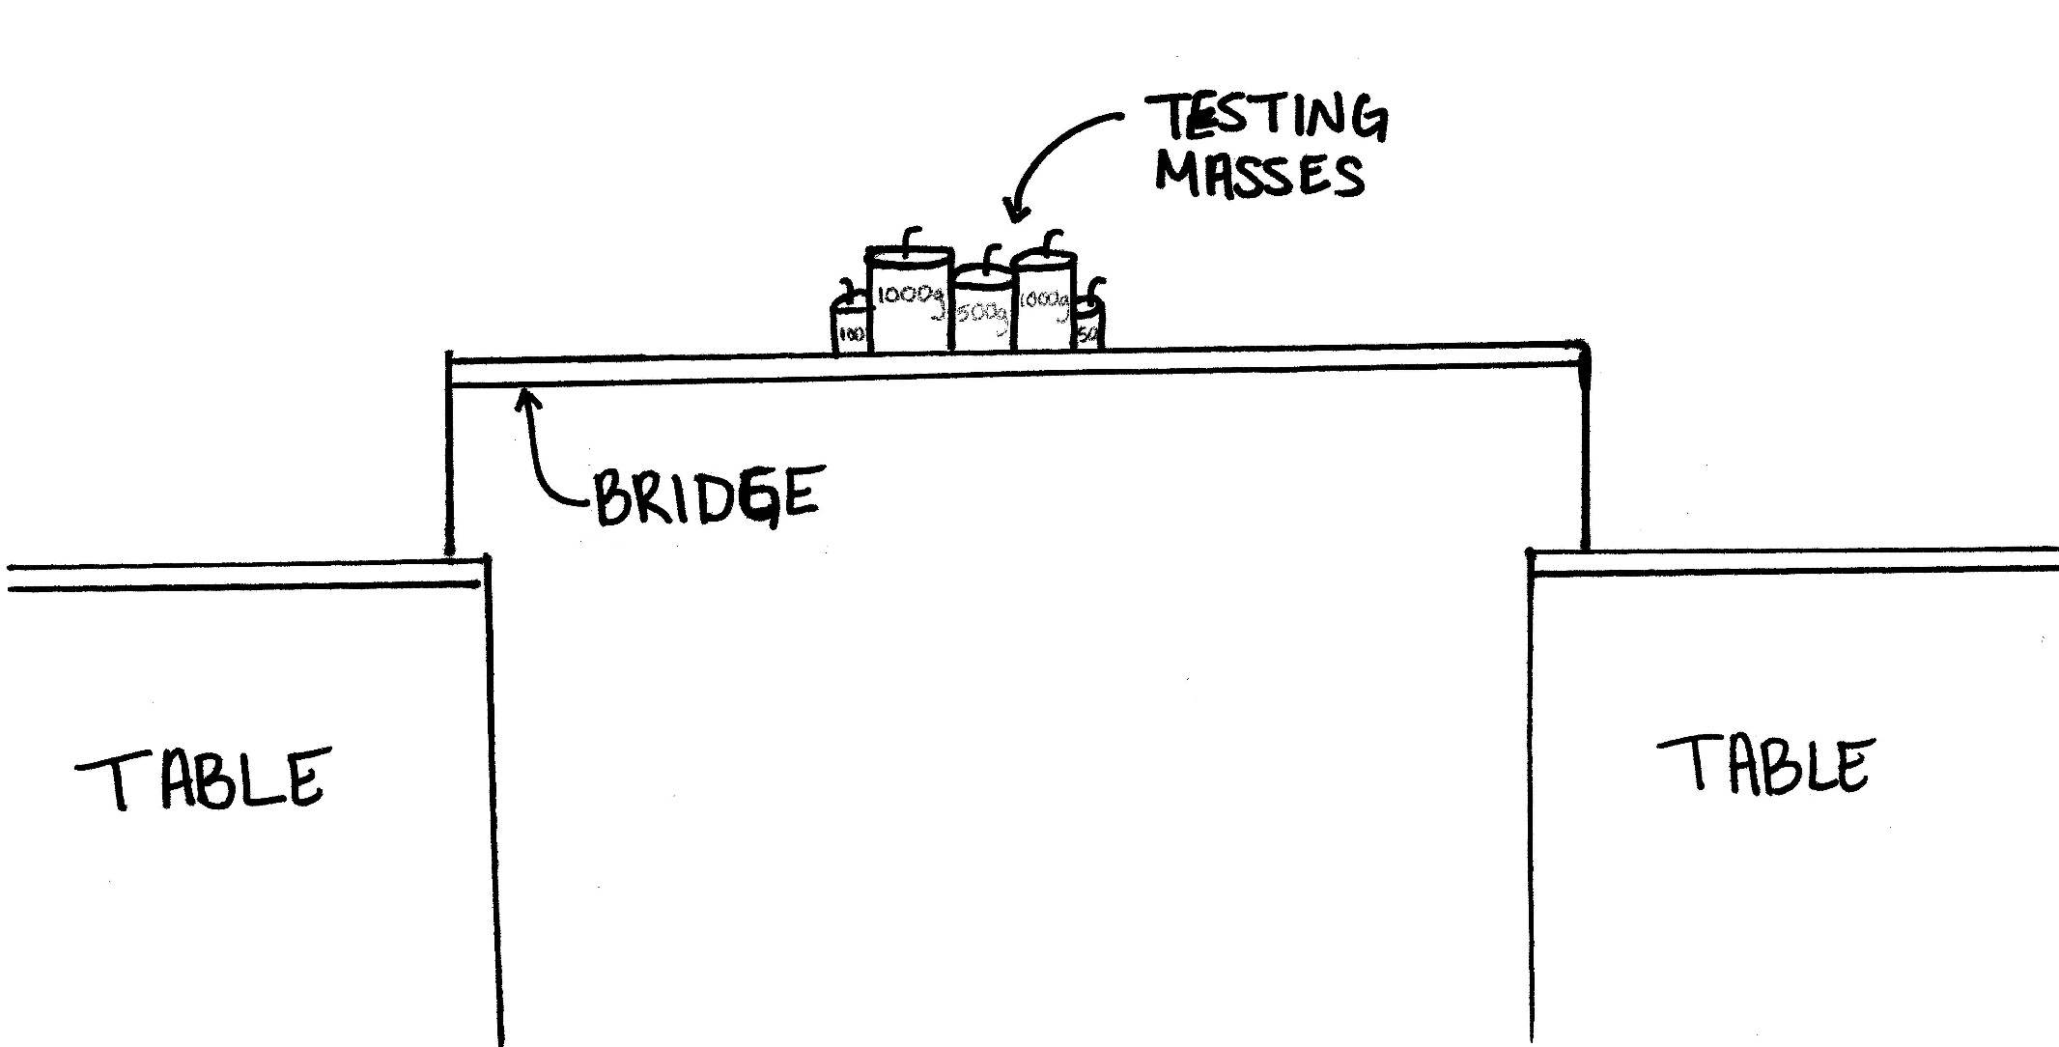
Bridge Testing Drawing Example

Slide 16
Counting Masses Example
Mass: | 1000 grams | 500 grams | 100 grams | 50 grams
Number of Masses the Bridge Held: | 2 | 1 | 1 | 1
Total Mass the Bridge Held: 2,650 grams

Slide 17
Concluding Questions
Who designs, engineers and builds bridges?
Why are bridges important for people?
What are the steps to making a bridge?
www.goodreads.com

