Slide 1
TURNING IDEAS INTO REALITY: ENGINEERING A BETTER WORLD
Holiday Catapult
www.discovere.org
Notes:
As the pre-activity survey is distributed to students, introduce yourself and provide enough of an activity overview to gain students excitement.
Allow time for students to individually complete their pre-activity survey.
Divide group into teams of 2 to 4 students

Slide 2
VOCABULARY WORDS:
Illustrious
Dire
Decrees
Ransack
Battlement
Lout
Consult
Duked
Chivalrous
Bounty
Fierce
Rapid
Volley
Bleak
Triumph

Slide 3
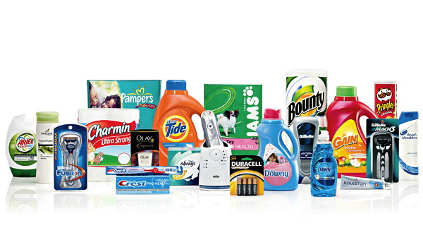
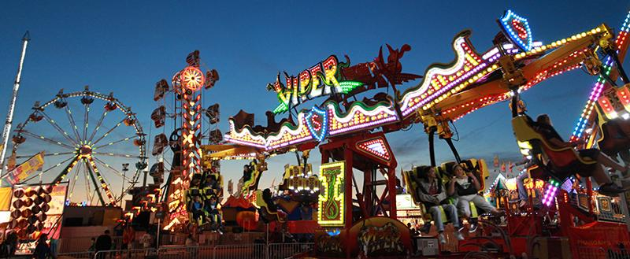
What does an engineer do?
Solve problems and shape the future!
Create and design new “things” essential to health, happiness and safety:
Chemical things – food, medicine, shampoo, fuel . . .
Building things – bridges, skyscrapers, roads…
Technology things – iPods, cameras, electronic gadgets . . .
Fun things – toys, roller coasters, sporting goods . . .
Important things – water systems, medical devices and tools . . .
Much, much more . . . the list is endless
images.businessweek.com
www.wistatefair.com
www.gettyimages.com
Notes:
Discuss engineering and what engineers do.

Slide 4
How do engineers do this?
Help others by solving all sorts of problems.
Use one of their most important tools: their own creativity.
Work in design teams.
Use cool tools such as computers, microscopes, testing machines, etc.
Communicate with lots of people about problems they need solved.
Share ideas and solutions with others through presentations and/or writing.
www.engineeringmessages.org
Notes:
Do all engineers do the same thing?
NO, NO, NO!!!!!
Many types of engineers
Chemical
Mechanical
Electrical
Civil
They do many different types of jobs
Design
Sale
Test
Much, much more!

Slide 5
Today you will be a mechanical engineer. You will design, build and test a catapult and cushioning system!
Engineering a Better World
Watch the Mythbusters videos!
https://www.youtube.com/watch?v=9-Hwxw4fgqk
https://www.youtube.com/watch?v=bHs5KC0SafU
Help launch presents into the castle because the Knights won’t open the door!
Notes:
Present the engineering design problem and challenge, following presentation:
Play video (1m, 12s).
https://www.youtube.com/watch?v=XggxeuFDaDU

Slide 6
Design Challenge Problem
You have arrived at a castle with a load of presents for the people inside, but the Knights won’t open the door!
In order to get the presents into the castle, you will need to build a catapult and fling the presents over the walls!
A great amount of force is being applied to the presents in order to transfer enough kinetic energy to them and give them enough speed to make it over the castle walls. Also, many presents can be damaged when they hit the ground at high speed.
You will need to solve this problem by designing a way to protect the presents from being damaged as they are sent into the castle.
Notes:
Present the real-world engineering design problem (scenario).

Slide 7
Engineering Design Challenge
Your team’s challenge is to build a catapult that will fling presents--represented by a cracker--over the walls. You also want to make certain that the cracker does not break when it hits the ground. So, you will design a way to safely transfer the potential energy in the catapult into kinetic energy in the cracker without the cracker breaking upon impact.
Your design can include only the materials provided.
Notes:
Introduce the Engineering Design Challenge, stressing that each team will only receive on packet of crackers and they have to be careful not to break them.

Slide 8
Design Goals
Create a working catapult that can fling a cracker.
Use only the materials your team purchased to create a cushioning system to protect the cracker from breaking.
Have fun!!
Notes:
Share Engineering Design Goals.

Slide 9
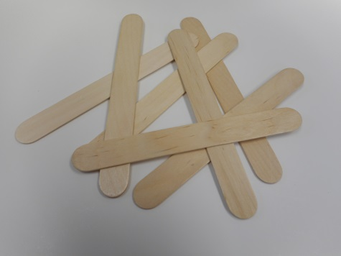
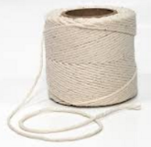
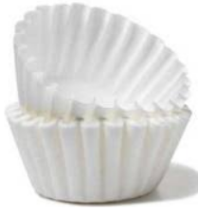
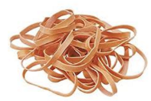
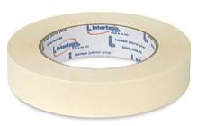
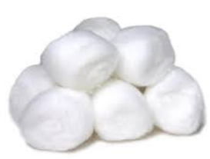
Materials
String Rubber Craft Masking Coffee Cotton Tissues
Bands Sticks Tape Filters Balls
Notes:
Introduce resources (materials) available to each team.

Slide 10
Design Testing
First get approval for your working catapult!
Once the catapult is approved, load a cushioned cracker and launch it.
If the cracker travels at least 30 centimeters and survives the impact, the design was successful!
Notes:
Explain prototype-testing procedures.
Have catapult placed on table where the floor is a three foot drop.
Have students launch catapult and contraption off the table and down the three foot drop.
If the cracker does not break, the design was successful.

Slide 11
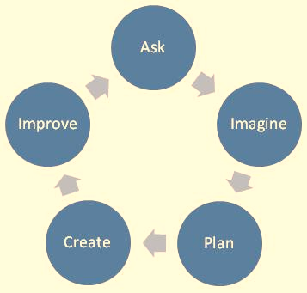
Engineering Design Process
ASK: What is the problem? How have others approached it? What are your constraints?
IMAGINE: What are some solutions? Brainstorm ideas. Choose the best one.
PLAN: Draw a diagram. Make lists of materials you will need.
CREATE: Follow your plan and create something. Test it out!
IMPROVE: What works? What doesn't? What could work better? Modify your designs to make it better. Test it out!
www.teachengineering.org
Notes:
Introduce the Engineering Design Process. Explain that engineers use it as a tool to help them more effectively solve problems.

Slide 12
Build a Catapult
First your team needs a catapult!
Follow this video’s instructions:
http://www.youtube.com/watch?v=XchdUB-ZnKc
2 sticks
3 rubber bands
8 sticks
Notes:
Play the video (2m19s), and have teams follow instructions to quickly build a catapult.
http://www.youtube.com/watch?v=XchdUB-ZnKc
Each group gets 8 craft sticks for the base and two for the stand and catapult arm.
Three rubber bands

Slide 13
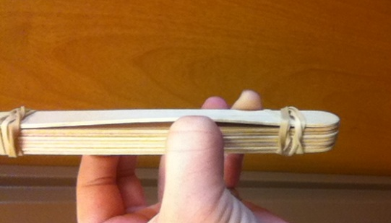
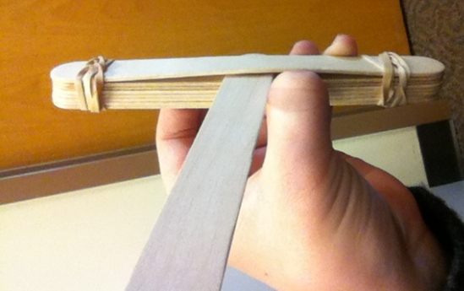
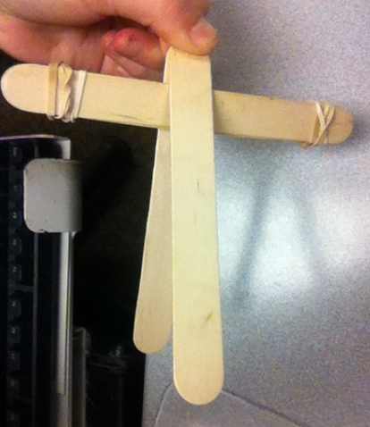
Divide sticks into one group of 8 and one group of 2. Gather 3 rubber bands.
Stack the 8 craft sticks and loosely wrap a rubber band around each end--about three or four times.
Lift up the last stick in the eight-stick pile, and insert one of the sticks from your two-stick pile into the space made by lifting between the pile.
Pinch the last craft stick to the stick you just inserted in-between two sticks in the eight-stick pile.
5. Wrap the last rubber band around the two sticks where you are pinching them. (Wrap as many times as possible.)
Notes:
Display the visual instructions for building a catapult as teams finish their catapults.

Slide 14
What materials do you, as a team, want to purchase to create your cushioning device?
String Rubber Craft Masking Coffee Cotton Tissues
Bands Sticks Tape Filters Balls

Slide 15
What will your cushioning device look like when you are finished building it?
Remember to use only the materials you purchased.
Creating a Cushioning Device
String Rubber Craft Masking Coffee Cotton Tissues
Bands Sticks Tape Filters Balls

Slide 16
Test Your Catapult and Cushioning Device
Be sure your targets are 30 centimeters from your catapult. Use a ruler to measure 30 centimeters.
If your cracker does not break, place your catapult on a table that is at least 60 centimeters from the floor. Use a ruler to measure 60 centimeters.

Slide 17
Design Reflection
What went well? Not so well? Why?
What aspects of other team designs stood out to you?
Did other designs give you ideas for ways to improve your design?
What modifications would you make if we had time to complete the design challenge again?
Notes:
Facilitate a whole group reflection on final prototype design and testing results by asking questions such as the following.
What do you like best about your design?
What do you like least about your design?
What aspects of other team designs stood out to you, and/or gave you ideas for improving your own team’s design?
What modifications would you make if we had time to complete the design challenge again?

Slide 18
Redesign Your Cushioning Device
Use what you learned from testing your cushioning device to redesign it. Remind yourself of these helpful questions:
What went well? Not so well? Why?
What aspects of other team designs stood out to you?
Did other designs give you ideas for ways to improve your design?
What modifications would you make if we had time to complete the design challenge again?

Slide 19
Wrap Up
What ideas do you have for engineering a better world?
How can you turn ideas into reality?
Notes:
Conclude by discussing the following questions as post-activity surveys are distributed.
What ideas do you have for engineering a better world?
How can you turn ideas into reality?

Slide 20
This material is based upon work supported by:
the National Science Foundation under Grant No. EEC – 1009607
EiF grant 14.06
Engineering Science Foundation of Dayton under Grant No. AD2018-0001
2017-18 grant from the Marianist Foundation.
References:
Ohio's new learning standards. Ohio department of education. 08 Aug 2014. Retrieved from: http://education.ohio.gov/Topics/Ohio-s-New-Learning-Standards/Ohios-New-Learning-Standards
www.discovere.org
Notes:
Allow time for students to complete their post-activity survey.

