Slide 1
TURNING IDEAS INTO REALITY: ENGINEERING A BETTER WORLD
Zip Line
This material is based upon work supported by the Engineering Science Foundation of Dayton under
Grant No. AD2018-0001 and through a 2017-18 grant from the Marianist Foundation.
www.discovere.org
Notes:
As the pre-activity survey is distributed to students, introduce yourself and provide enough of an activity overview to gain students excitement.
Allow time for students to individually complete their pre-activity survey.
Divide group into teams of 3 to 4 students each.

Slide 2
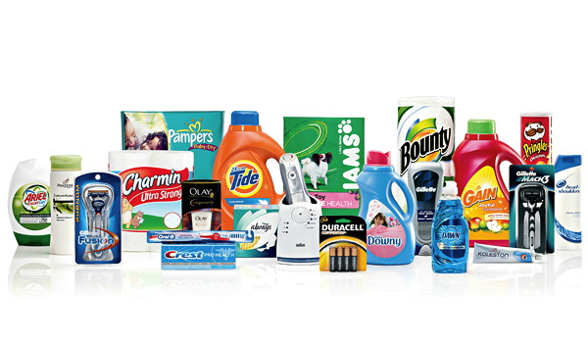
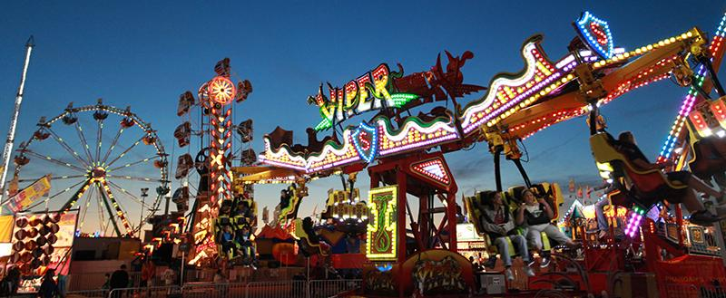
What does an engineer do?
Solve problems and shape the future!
Create and design new “things” essential to health, happiness, and safety:
Chemical things – food, medicine, shampoo, fuels…
Building things – bridges, skyscrapers, roads…
Technology things – iPods, Cameras, electronic gadgets…
Fun things – toys, roller coasters, sporting goods...
Important things – water systems, medical devices and tools…
Much, much more….the list is endless
images.businessweek.com
www.wistatefair.com
www.gettyimages.com
This material is based upon work supported by the Engineering Science Foundation of Dayton under
Grant No. AD2018-0001 and through a 2017-18 grant from the Marianist Foundation.
Notes:
Discuss engineering and what engineers do.

Slide 3
How do engineers do this?
Help others by solving all sorts of problems
Use one of their most important tools: their own creativity
Work in design teams
Use cool tools such as computers, microscopes, testing machines, etc.
Communicate with lots of people about problems they need solved
Share ideas and solutions with others through presentations and/or writing
www.engineeringmessages.org
This material is based upon work supported by the Engineering Science Foundation of Dayton under
Grant No. AD2018-0001 and through a 2017-18 grant from the Marianist Foundation.
Notes:
Discuss engineering and what engineers do.
Do all engineers do the same thing?
NO, NO, NO!!!!!
Many types of engineers
Chemical
Mechanical
Electrical
Civil
They do many different types of jobs
Design
Sale
Test
Much, much more!

Slide 4
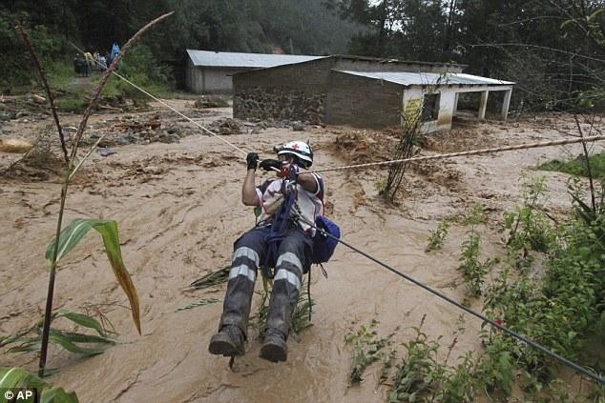
Today you will be a civil engineer – You will design, build, and test a zip line!
Engineering a Better World
There has been a hurricane! People can’t get to safety by foot, automobiles, airplanes, or boats.
The only way to get people to safety is using a zip line!
“Zip Line Rescues from Mexico Floods”
Watch the video
This material is based upon work supported by the Engineering Science Foundation of Dayton under
Grant No. AD2018-0001 and through a 2017-18 grant from the Marianist Foundation.
Notes:
Show “Zipline Rescues from Mexico Floods” video –
NOTE: Video must be ended abruptly at 1m14s.
http://www.nbcnews.com/video/nightly-news/53044233#53044233
*may have to copy and paste link into browser
detailed scenario. - A recent earthquake has collapsed a bridge, which was the only way out of an island. The islanders are running out of resources quickly, and need help. Your engineering team has concluded that the best and safest option is to transport the people off the island. The water’s current is currently too strong, making it an unsafe means of transportation. The only means of transportation remaining is the island’s famous zip line, which includes a section leading from the island to a neighboring city.

Slide 5
Engineering Design Problem
A recent hurricane collapsed a bridge, which was the only way off of an island. The islanders are running out of resources quickly and need help.
Your engineering team has concluded that the best, and safest, option is to transport the people off the island. The water’s current is too strong; therefore, boats cannot be used to transport people off of the island.
The only means of transportation remaining is the island’s famous zip line, which includes a section leading from the island to a neighboring city.
www.engineeringmessages.org
This material is based upon work supported by the Engineering Science Foundation of Dayton under
Grant No. AD2018-0001 and through a 2017-18 grant from the Marianist Foundation.
Notes:
Present the real-world engineering design problem.

Slide 6
Engineering Design Challenge
Your team’s challenge is to design and create a cradle that will safely transport one islander at a time across the zip line from the island to the neighboring city.
www.engineeringmessages.org
This material is based upon work supported by the Engineering Science Foundation of Dayton under
Grant No. AD2018-0001 and through a 2017-18 grant from the Marianist Foundation.
Notes:
Introduce the Engineering Design Challenge.

Slide 7
Design Goals
Your team of engineers will design cradle that holds and transports islanders along a zip line and off the island.
Your design must cradle and transport one LEGO person at a time to safety.
Only materials supplied to your may be used.
Hold your design at the top of the zip line, force its potential energy to transform to kinetic energy by giving it a push.
You may not help your design complete its movement across the zip line.
Have fun!!
This material is based upon work supported by the Engineering Science Foundation of Dayton under
Grant No. AD2018-0001 and through a 2017-18 grant from the Marianist Foundation.
Notes:
Discuss Engineering Design Goals.

Slide 8
Materials
This material is based upon work supported by the Engineering Science Foundation of Dayton under
Grant No. AD2018-0001 and through a 2017-18 grant from the Marianist Foundation.
Notes:
Introduce resources (materials) available to each team.
You will have: straws, masking tape, string/yarn, toothpicks, duct tape, paper clips, pipe cleaners, wooden craft sticks, ribbon, rubber bands, and cups.
If constraining material quantities – use these amounts for each group
Straws, 5 total
Masking tape, 3 in
String/yarn, 1 ft
Tooth picks, 8 total
Duct tape, 2 inches
Paperclips, 3 total
Pipe cleaners, 2 each
Wooden craft sticks, 4 each
Ribbon, 5 inches
Rubber bands, 5 total
Cups, 1 each

Slide 9
Design Testing
The cradle must hold one LEGO person.
Only one push from the top may be used to begin the cradle’s motion.
This material is based upon work supported by the Engineering Science Foundation of Dayton under
Grant No. AD2018-0001 and through a 2017-18 grant from the Marianist Foundation.
Notes:
Explain prototype-testing procedures.

Slide 10
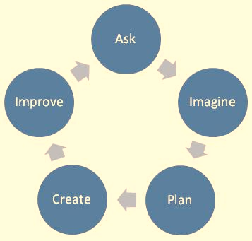
Engineering Design Process
ASK: What is the problem? How have others approached it? What are your constraints?
IMAGINE: What are some solutions? Brainstorm ideas. Choose the best one.
PLAN: Draw a diagram. Make lists of materials you will need.
CREATE: Follow your plan and create something. Test it out!
IMPROVE: What works? What doesn't? What could work better? Modify your designs to make it better. Test it out!
www.teachengineering.org
This material is based upon work supported by the Engineering Science Foundation of Dayton under
Grant No. AD2018-0001 and through a 2017-18 grant from the Marianist Foundation.
Notes:
Introduce the Engineering Design Process. Explain that engineers use it as a tool to help them more effectively solve problems.

Slide 11
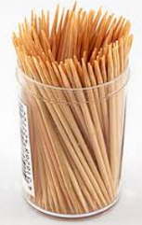
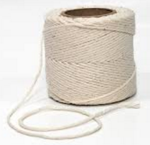
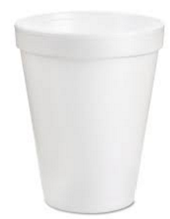
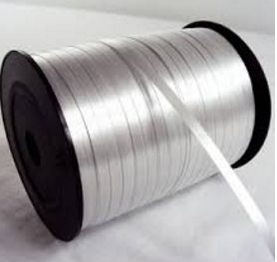
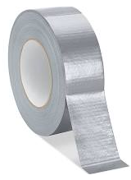
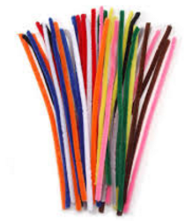
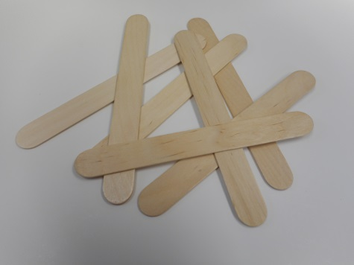
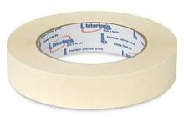
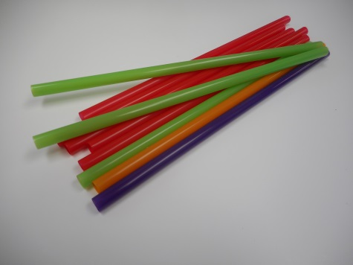
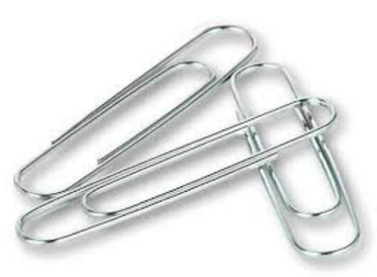
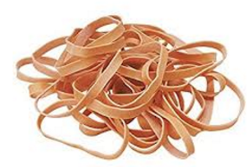
Engineering Design Process,
Ask
Ask yourself: What materials would I like to use to create a cradle that will safely transport one islander at a time across the zip line?
Write these materials on your “STEM Challenge” handout.
Tooth String Cups Ribbon
Picks
Craft Masking Duct
Sticks Tape Tape
Rubber Straws Pipe- Paper Clips
Bands Cleaners
This material is based upon work supported by the Engineering Science Foundation of Dayton under
Grant No. AD2018-0001 and through a 2017-18 grant from the Marianist Foundation.
Notes:
Explain how teams will use the engineering design process as they complete the challenge:
Ask (10 mins.)

Slide 12
Engineering Design Process, Imagine
Imagine what your cradle will look like.
Draw a picture or write a description of the cradle you would like to create.
Tooth String Cups Ribbon
Picks
Craft Masking Duct
Sticks Tape Tape
Rubber Straws Pipe- Paper Clips
Bands Cleaners
This material is based upon work supported by the Engineering Science Foundation of Dayton under
Grant No. AD2018-0001 and through a 2017-18 grant from the Marianist Foundation.
Notes:
Explain how teams will use the engineering design process as they complete the challenge:
Imagine (10 mins.)
Ask the students to notice that the word Imagine is in one of the circles of the “Engineering Design Process”.
Students should Imagine what their houses will look like.
Students should draw a picture or write a description of their house on their STEM Challenge handout.
Walk around as the students complete the Imagine step of the Engineering Design Process.

Slide 13
Sharing Time!
Put on your listening ears and, one at a time, share your ideas!
https://www.pinterest.com/pin/102245854020359820/?lp=true
This material is based upon work supported by the Engineering Science Foundation of Dayton under
Grant No. AD2018-0001 and through a 2017-18 grant from the Marianist Foundation.
Notes:
Walk around as the students share their ideas with their teammates. Make sure that each student is given ample time to share his or her ideas. Students get excited about wanting to create a cradle and often rush through the sharing process. Remind students that the sharing process is extremely important as engineers often alter their designs based on ideas shared during the brainstorming process.

Slide 14
Engineering Design Process,
Plan
Plan what your cradle will look like.
Draw a picture or write a description of the cradle your team will build.
Tooth String Cups Ribbon
Picks
Craft Masking Duct
Sticks Tape Tape
Rubber Straws Pipe- Paper Clips
Bands Cleaners
This material is based upon work supported by the Engineering Science Foundation of Dayton under
Grant No. AD2018-0001 and through a 2017-18 grant from the Marianist Foundation.
Notes:
Explain how teams will use the engineering design process as they complete the challenge:
Plan
Ask the students to notice that the word Plan is in one of the circles of the “Engineering Design Process”.
Students should Plan as a team what their cradle will look like.
Students can use a teammates’ ideas or a combination of the teams’ ideas. But remind them that they must create one cradle together as a team!
Students should draw a picture or write a description of their cradle on their STEM Challenge handout.
Walk around as the students complete the Plan step of the Engineering Design Process.

Slide 15
Buying Time!
What materials do you, as a team, want to purchase to build your cushioning device?
Tooth String Cups Ribbon
Picks
Craft Masking Duct
Sticks Tape Tape
Rubber Straws Pipe- Paper Clips
Bands Cleaners
This material is based upon work supported by the Engineering Science Foundation of Dayton under
Grant No. AD2018-0001 and through a 2017-18 grant from the Marianist Foundation.

Slide 16
Create a Cradle
Create a cradle that will hold one LEGO person
Create a cradle that will slide from the top to the bottom of the zip line with only one push
Use only the materials that are available
Create a cradle in the given time.
Create a cradle on wax paper.
This material is based upon work supported by the Engineering Science Foundation of Dayton under
Grant No. AD2018-0001 and through a 2017-18 grant from the Marianist Foundation.
Notes:
Instruct students to create their cradle on the wax paper.
As the students are creating their cradles, walk around the room and ask them probing questions about their design. For example:
What are your reasons for selecting that material for the cradle?
What are your reasons for selecting that material to hook the cradle to the zip line?

Slide 17
Test Your Cradle Time!
Does one LEGO person stay in your cradle while the cradle moves from the top to the bottom of the zip line?
Did your cradle slide from the top to the bottom of the zip line with only one push?
This material is based upon work supported by the Engineering Science Foundation of Dayton under
Grant No. AD2018-0001 and through a 2017-18 grant from the Marianist Foundation.
Notes:
Each team tests their prototype while other teams observe.

Slide 18
Design Reflection
What went well? Not so well? Why?
What modifications would you make if we had time to complete the design challenge again?
Did other designs give you ideas for ways to improve your design?
Do you think that changing the slope (angle) of the zip line would make a difference?
How did transformations between potential energy and kinetic energy force your design to move along the zip line?
What role did friction play on the safety and speed of your design as people were transported along the zip line?
www.engineeringmessages.org
This material is based upon work supported by the Engineering Science Foundation of Dayton under
Grant No. AD2018-0001 and through a 2017-18 grant from the Marianist Foundation.
Notes:
Facilitate a whole group reflection on final prototype design and testing results by asking questions such as the following.
What do you like best about your design?
What do you like least about your design?
What aspects of other team designs stood out to you, and/or gave you ideas for improving your own team’s design?
What modifications would you make if we had time to complete the design challenge again?
Do you think that changing the slope (angle) of the zip line would make a difference?
How did transformations between potential energy and kinetic energy force your design to move along the zip line?
What role did friction play on the safety and speed of your design as people were transported along the zip line?

Slide 19
Improve Your Cradle
Discuss with your team:
How can you improve your cradle?
Engineering Design Process
This material is based upon work supported by the Engineering Science Foundation of Dayton under
Grant No. AD2018-0001 and through a 2017-18 grant from the Marianist Foundation.
Notes:
Ask the students to notice that the word Improve is in one of the circles of the “Engineering Design Process”.
Students should discuss how they can Improve their cradle.
Students can use a teammates’ ideas or a combination of the teams’ ideas, but remind them that they must create one cradle together as a team!
Students should draw a picture or write a description of their cradle on their STEM Challenge handout.

Slide 20
Create an Improved Cradle
Create a cradle that will hold one LEGO person
Create a cradle that will slide from the top to the bottom of the zip line with only one push
Use only the materials that are available
Create a cradle in the given time.
Create a cradle on wax paper.
This material is based upon work supported by the Engineering Science Foundation of Dayton under
Grant No. AD2018-0001 and through a 2017-18 grant from the Marianist Foundation.
Notes:
Instruct students to create their cradle on the wax paper.
As the students are building their cradles, walk around the room and ask them probing questions about their design. For example:
What are your reasons for selecting that material for the cradle?
What are your reasons for selecting that material to hook the cradle to the zip line?

Slide 21
Test Your Improved Cradle
Does one LEGO person stay in your cradle while the cradle moves from the top to the bottom of the zip line?
Did your cradle slide from the top to the bottom of the zip line with only one push?
This material is based upon work supported by the Engineering Science Foundation of Dayton under
Grant No. AD2018-0001 and through a 2017-18 grant from the Marianist Foundation.
Notes:
Each team tests their cradle while other teams observe.

Slide 22
Design Reflection
What went well? Not so well? Why?
What modifications would you make if we had time to complete the design challenge again?
Did other designs give you ideas for ways to improve your design?
Do you think that changing the slope (angle) of the zip line would make a difference?
How did transformations between potential energy and kinetic energy force your design to move along the zip line?
What role did friction play on the safety and speed of your design as people were transported along the zip line?
www.engineeringmessages.org
This material is based upon work supported by the Engineering Science Foundation of Dayton under
Grant No. AD2018-0001 and through a 2017-18 grant from the Marianist Foundation.
Notes:
Facilitate a whole group reflection on final prototype design and testing results by asking questions such as the following.
What do you like best about your design?
What do you like least about your design?
What aspects of other team designs stood out to you, and/or gave you ideas for improving your own team’s design?
What modifications would you make if we had time to complete the design challenge again?
Do you think that changing the slope (angle) of the zip line would make a difference?
How did transformations between potential energy and kinetic energy force your design to move along the zip line?
What role did friction play on the safety and speed of your design as people were transported along the zip line?

Slide 23
Wrap Up
What ideas do you have for engineering a better world?
How can you turn ideas into reality?
www.engineeringmessages.org
This material is based upon work supported by the Engineering Science Foundation of Dayton under
Grant No. AD2018-0001 and through a 2017-18 grant from the Marianist Foundation.
Notes:
Conclude by discussing the following questions as post-activity surveys are distributed.
What ideas do you have for engineering a better world?
How can you turn ideas into reality?

Slide 24
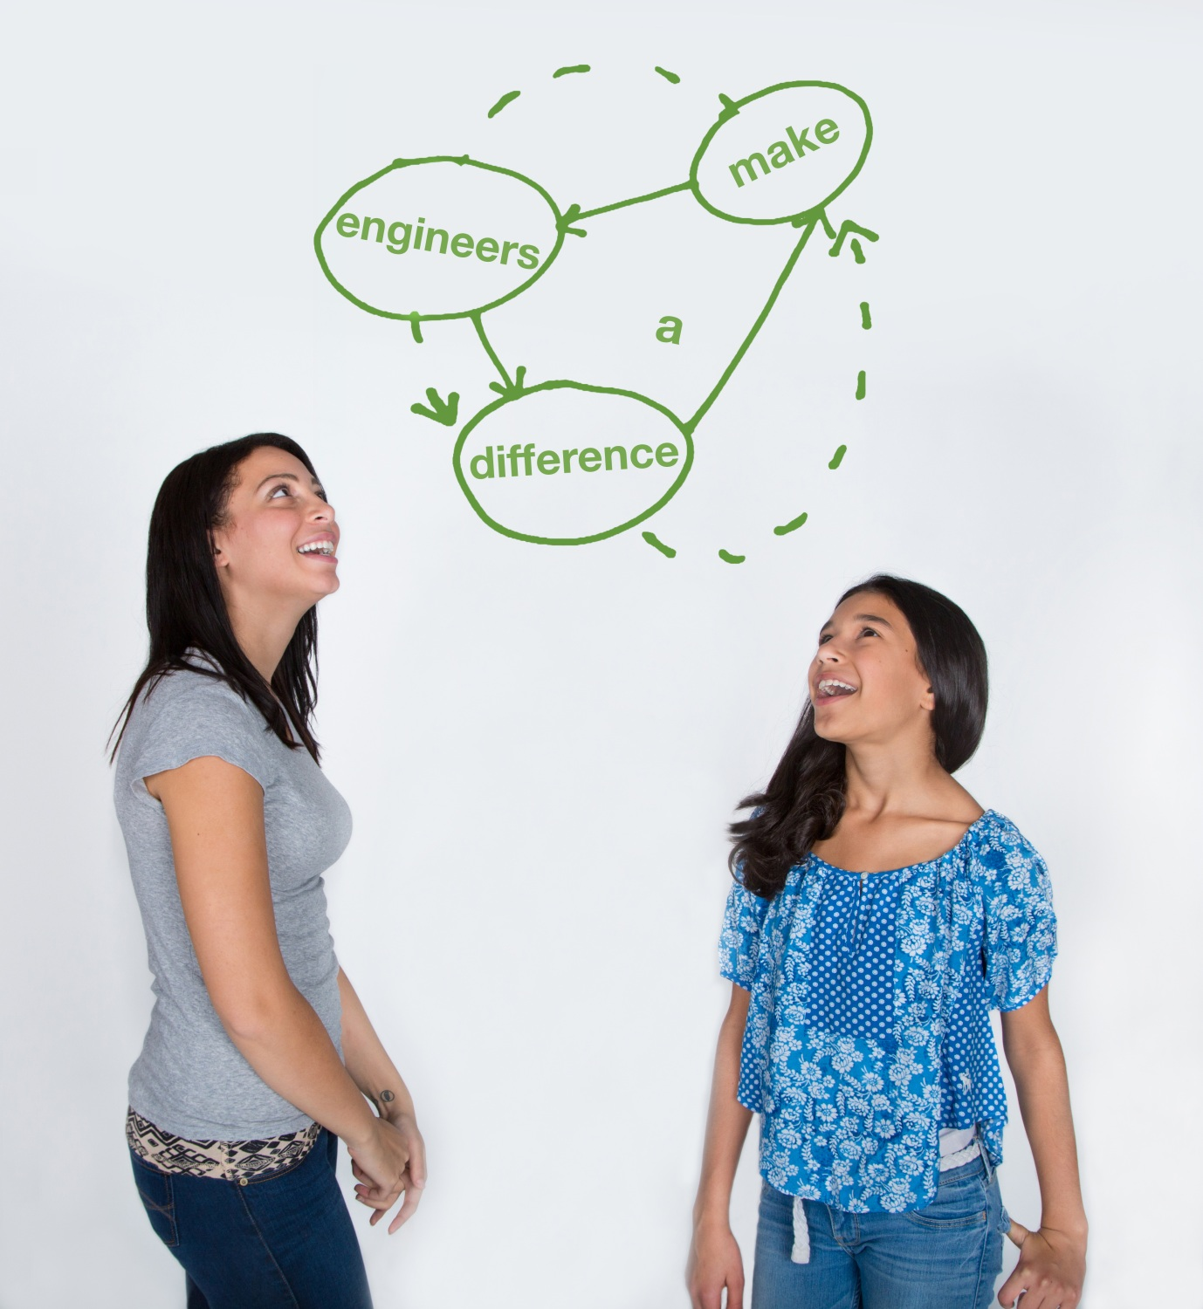
This material is based upon work supported by:
the National Science Foundation under Grant No. EEC – 1009607
EiF grant 14.06
Engineering Science Foundation of Dayton under Grant No. AD2018-0001
2017-18 grant from the Marianist Foundation.
References:
This activity has been adapted from the Rescue Rover and Conveyor Belt activities provided from tryengineering.com.
Conveyor Engineering - http://www.tryengineering.org/lesson-plans/conveyor-engineering
Rescue Rover - http://www.tryengineering.org/lesson-plans/rescue-rover
Zipline rescues from Mexico floods. NBCNews.com. NBC nightly news, 18 Sept 2013. Retrieved from: http://www.nbcnews.com/video/nightly-news/53044233#53044233.
Thank you for the funding through the Engineering Information Foundation, NBC Nightly News, Smooth Operator Presentation by Margaret Pinnell, PhD.
This material is based upon work supported by the Engineering Science Foundation of Dayton under
Grant No. AD2018-0001 and through a 2017-18 grant from the Marianist Foundation.
www.discovere.org
Notes:
Allow time for students to complete their post-activity survey.

