Slide 1
STEM Stories Volcano Rising Presentation
TURNING IDEAS INTO REALITY: ENGINEERING A BETTER WORLD
Volcano Rising
www.discovere.org
Notes:
As the pre-activity survey is distributed to students, introduce yourself and provide enough of an activity overview to gain students excitement. Set up testing area with the pan and have materials for toothpaste ready and organized.
Allow time for students to individually complete their pre-activity survey.
Divide group into teams of 3 or 4 students.

Slide 2
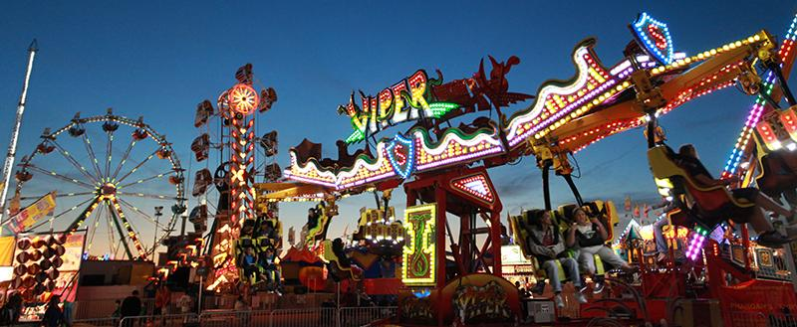
What does an engineer do?
Solve problems and shape the future!
Create and design new “things” essential to health, happiness and safety:
Chemical things – food, medicine, shampoo, fuels . . .
Building things – bridges, skyscrapers, roads . . .
Technology things – iPods, cameras, electronic gadgets . . .
Fun things – toys, roller coasters, sporting goods . . .
Important things – water systems, medical devices and tools . . .
Much, much more . . . the list is endless
images.businessweek.com
www.wistatefair.com
www.gettyimages.com
Notes:
Discuss engineering and what engineers do.

Slide 3
How do engineers do this?
Help others by solving all sorts of problems.
Use one of their most important tools: their own creativity.
Work in design teams.
Use cool tools such as computers, microscopes, testing machines, etc.
Communicate with lots of people about problems they need solved.
Share ideas and solutions with others through presentations and/or writing.
www.engineeringmessages.org
Notes:
Do all engineers do the same thing?
NO, NO, NO!!!!!
Many types of engineers
Chemical
Mechanical
Electrical
Civil
They do many different types of jobs
Design
Sale
Test
Much, much more!

Slide 4
Today you will be a civil engineer. You will design, create and test a product to protect your building from lava!
Engineering a Better World
Watch Video!
https://www.youtube.com/watch?v=UK--hvgP2uY
Notes:
Present the engineering design problem and challenge, following presentation:
Play video (1m 49s).

Slide 5
STEM Stories Volcano Rising Engineering Design Problem
Engineering Design Problem
Mount St. Helens is erupting shortly.
Buildings will be destroyed if action is not taken quickly to protect them.
Notes:
Present the real-world engineering design problem (scenario).

Slide 6
STEM Stories Volcano Rising Engineering Design Challenge
Engineering Design Challenge
Your team’s challenge is to create a structure that will save the surrounding buildings before the lava places the civilians in danger.
You have around 15 minutes to complete the task and save the building from the flow.
Notes:
Introduce the Engineering Design Challenge.

Slide 7
Design Goals
Create a design that protects the building.
Must be built in time given.
Can only use materials you purchase and within limits given.
Have fun!!
Notes:
Share Engineering Design Goals.

Slide 8
Materials
Notes:
Introduce resources (materials) available to each team.
If constraining materials, each group can use-
Wooden Craft Sticks
Masking Tape
Duct Tape
Straws
Foam Plate
Cardboard
Foam Cup
Crayola Modeling Clay
Foil
Lego Blocks
Toothpicks

Slide 9
Design Testing
Three groups will bring their designs to the testing tin where the houses are set up.
The facilitator will mix the reaction and advise students to step back and observe.
The designs will be evaluated based on the level of protection their design provided from the lava flow.
The groups will continue to be tested in groups of three until all groups have tested their design.
Place the houses in the tin spread apart in marked three areas. Have groups place their design where they determine would be the best spot to implement their design.
Notes:
Explain how teams will work.
Explain prototype-testing procedures.

Slide 10
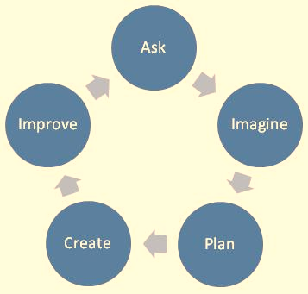
Engineering Design Process
ASK: What is the problem? How have others approached it? What are your constraints?
IMAGINE: What are some solutions? Brainstorm ideas. Choose the best one.
PLAN: Draw a diagram. Make lists of materials you will need.
CREATE: Follow your plan and create something. Test it out!
IMPROVE: What works? What doesn't? What could work better? Modify your designs to make it better. Test it out!
www.teachengineering.org
Notes:
Introduce the Engineering Design Process. Explain that engineers use it as a tool to help them more effectively solve problems.

Slide 11
Engineering Design Process:
Imagine (10 min.)
INDIVIDUALLY: observe available materials, and brainstorm and write design ideas (5 min.)
TEAM: share individual ideas (5 min.)
Plan (10 min.)
Choose and sketch a team design plan
Create (10 min.)
Gather materials
Construct your team design plan
Improve and Test (10 min.)
Notes:
Explain how teams will use the engineering design process as they complete the challenge.
Brainstorm:
Each individual in a team must write or sketch one or two ideas.
Team must discuss each idea.
Team decides criteria most important to them while keeping constraints (limited time and materials, etc.) in mind.
Create Team Prototype:
Teams choose, sketch, and outline their prototype design idea.
Teams have idea approved by facilitator.
Gather Materials:
Teams receive their bag of materials (prepared in advance).
Create Chosen Design:
Team creates their approved prototype design plan.
Final Test:
Each team tests their prototype while other teams observe.

Slide 12
Design Reflection
What went well? Not so well? Why?
What aspects of other team designs stood out to you?
Did other designs give you ideas for ways to improve your design?
What modifications would you make if we had time to complete the design challenge again?
How does the type of material chosen affect your structure’s ability to withstand a lava flow?
How does the shape of your structure affect its ability to withstand a lava flow?
Notes:
Facilitate a whole group reflection on final prototype design and testing results by asking questions such as the following.
What do you like best about your design?
What do you like least about your design?
What aspects of other team designs stood out to you, and/or gave you ideas for improving your own team’s design?
What modifications would you make if we had time to complete the design challenge again?

Slide 13
Wrap Up
What ideas do you have for engineering a better world?
How can you turn ideas into reality?
Notes:
Conclude by discussing the following questions as post-activity surveys are distributed.
What ideas do you have for engineering a better world?
How can you turn ideas into reality?

Slide 14
Support and References
This material is based upon work supported by:
the National Science Foundation under Grant No. EEC – 1009607
EiF grant 14.06
Engineering Science Foundation of Dayton under Grant No. AD2018-0001
2017-18 grant from the Marianist Foundation.
References:
Ohio's new learning standards. Ohio department of education. 08 Aug 2014. Retrieved from: http://education.ohio.gov/Topics/Ohio-s-New-Learning-Standards/Ohios-New-Learning-Standards
www.discovere.org
Notes:
Allow time for students to complete their post-activity survey.

