Slide 1
TURNING IDEAS INTO REALITY: ENGINEERING A BETTER WORLD
If I Built a House
www.discovere.org
Notes:
As the pre-activity survey is distributed to students, introduce yourself and provide enough of an activity overview to gain students excitement.
Allow time for students to individually complete their pre-activity survey.
Divide group into teams of 3 students each (4 students will also work).

Slide 2
What does an engineer do?
Solve problems and shape the future!
Create and design new “things” essential to health, happiness and safety:
Chemical things – food, medicine, shampoo, fuels…
Building things – bridges, skyscrapers, roads…
Technology things – iPods, Cameras, electronic gadgets…
Fun things – toys, roller coasters, sporting goods...
Important things – water systems, medical devices and tools…
Much, much more….the list is endless
images.businessweek.com
www.wistatefair.com
www.gettyimages.com
Notes:
Discuss engineering and what engineers do.

Slide 3
How do engineers do this?
Help others by solving all sorts of problems.
Use one of their most important tools: their own creativity.
Work in design teams.
Use cool tools such as computers, microscopes, testing machines, etc.
Communicate with lots of people about problems they need solved.
Share ideas and solutions with others through presentations and/or writing.
www.engineeringmessages.org
Notes:
Do all engineers do the same thing?
NO, NO, NO!!!!!
Many types of engineers
Chemical
Mechanical
Electrical
Civil
They do many different types of jobs
Design
Sale
Test
Much, much more!

Slide 4
During this project, you will be a civil engineer! You will design and build a house. You will then test your house against wind, rain, and hail.
Engineering a Better World
Notes:
Explain that they will be taking on the role of civil engineers as they design and build a house.

Slide 5
Design Challenge Problem
You have finally earned enough money to build the house of your dreams near a Florida beach.
There are hurricanes and tropical storms often along the Florida beaches and many other coastal cities along the eastern and southern shorelines in the United States.
Therefore, you want to make sure your structure is built to withstand the destructive forces of a hurricane’s wind, rain, and hail.
www.engineeringmessages.org
Notes:
Present the real-world engineering design problem (scenario).
You have finally earned enough money to build the house of your dreams near the beach in Florida. Unfortunately, hurricanes and tropical storms are a frequent occurrence in the area you are building. You must make sure that your home is built efficiently to withstand wind, rain, and hail. If not built properly, you may lose everything you have worked for in order to build your house. Given some materials, you will build a house that will be tested with a fan, water, and spilling beans.

Slide 6
Engineering Design Challenge
Your team’s challenge is to build the house of your dreams that can withstand the destructive forces of a hurricane’s wind, rain, and hail.
www.engineeringmessages.org
Notes:
Present the real-world engineering design problem (scenario).
You have finally earned enough money to build the house of your dreams near the beach in Florida. Unfortunately, hurricanes and tropical storms are a frequent occurrence in the area you are building. You must make sure that your home is built efficiently to withstand wind, rain, and hail. If not built properly, you may lose everything you have worked for in order to build your house. Given some materials, you will build a house that will be tested with a fan, water, and spilling beans.

Slide 7
Design Goals
Build a house to withstand the forces of wind, rain, and hail.
Use only the materials that are available.
Build a house in the given time.
Build a house on wax paper.
Build a house with a length, width, and height less than 6 inches.
Build a house with both walls and a roof.
Notes:
Discuss Engineering Design Goals.

Slide 8
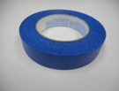
Materials
Cards Straws Craft Play-Doh Tape Glue
Sticks
Notes:
Explain how teams will use the engineering design process as they complete the challenge:
Ask (10 mins.)
Ask the students to notice that the word Ask is in one of the circles of the “Engineering Design Process”.
Explain to the students to Ask themselves: What materials would you like to use to build a house that can withstand wind, rain, and hail?
Students should write these materials on their STEM Challenge handout.
Walk around as the students complete the Ask step of the Engineering Design Process.

Slide 9
Design Testing
Environmental Variables | Tools Used | Criteria
Wind | Blow Dryer | 5 inches away from House
Rain | Water | Pour 3 feet above house.
Hail | Beans | Pour 3 feet above house.
Notes:
Explain prototype-testing procedures.

Slide 10
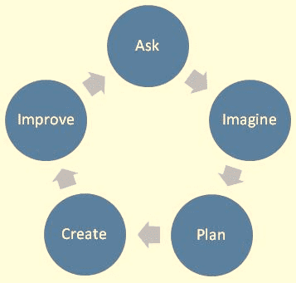
Engineering Design Process
ASK: What is the problem? How have others approached it? What are your constraints?
IMAGINE: What are some solutions? Brainstorm ideas. Choose the best one.
PLAN: Draw a diagram. Make lists of materials you will need.
CREATE: Follow your plan and create something. Test it out!
IMPROVE: What works? What doesn't? What could work better? Modify your designs to make it better. Test it out!
www.teachengineering.org
Notes:
Introduce the Engineering Design Process. Explain that engineers use it as a tool to help them more effectively solve problems.

Slide 11
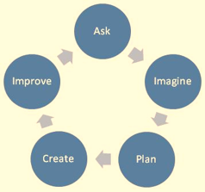
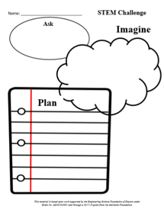
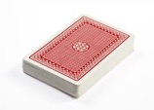
Engineering Design Process -Ask
Ask yourself:
What materials would I like to use to build a house that can withstand wind, rain, and hail?
Write these materials on their “STEM Challenge” handout.
Cards Straws Craft Play-Doh Tape Glue
Sticks
Notes:
Explain how teams will use the engineering design process as they complete the challenge:
Ask (10 mins.)
Ask the students to notice that the word Ask is in one of the circles of the “Engineering Design Process”.
Explain to the students to Ask themselves: What materials would you like to use to build a house that can withstand wind, rain, and hail?
Students should write these materials on their STEM Challenge handout.
Walk around as the students complete the Ask step of the Engineering Design Process.

Slide 12
Engineering Design Process – Imagine
Imagine what your house will look like.
Draw a picture or write a description of the house you would like to build on you STEM Challenge handout.
Cards Straws Craft Play-Doh Tape Glue
Sticks
Notes:
Explain how teams will use the engineering design process as they complete the challenge:
Ask (10 mins.)
Ask the students to notice that the word Ask is in one of the circles of the “Engineering Design Process”.
Explain to the students to Ask themselves: What materials would you like to use to build a house that can withstand wind, rain, and hail?
Students should write these materials on their STEM Challenge handout.
Walk around as the students complete the Ask step of the Engineering Design Process.

Slide 13
Sharing Time!
Put on your listening ears and, one at a time, share your ideas!
https://www.pinterest.com/pin/102245854020359820/?lp=true
Notes:
Walk around as the students share their ideas with their teammates. Make sure that each student is given ample time to share his or her ideas. Students get excited about wanting to build the houses and often rush through the sharing process. Remind students that the sharing process is extremely important as engineers often alter their designs based on ideas shared during the brainstorming process.

Slide 14
Engineering Design Process - Plan
Plan what your house will look like as a team.
Draw a picture or write a description of the house your team will build.
Cards Straws Craft Play-Doh Tape Glue
Sticks
Notes:
Explain how teams will use the engineering design process as they complete the challenge:
Ask (10 mins.)
Ask the students to notice that the word Ask is in one of the circles of the “Engineering Design Process”.
Explain to the students to Ask themselves: What materials would you like to use to build a house that can withstand wind, rain, and hail?
Students should write these materials on their STEM Challenge handout.
Walk around as the students complete the Ask step of the Engineering Design Process.

Slide 15
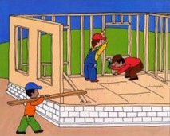
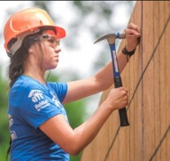
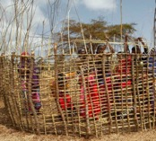
Building Time!
Build a house to withstand the forces of wind, rain, and hail.
Use only the materials you purchased.
Build a house in the given time.
Build a house on wax paper.
Build a house with a length, width, and height less than 6 inches.
Build a house with both walls and a roof.
Image from Building a House by Bryon Barton
http://www.troymessenger.com/2017/05/16/women-build-women-work-on-habitat-house/
http://www.alamy.com/stock-photo-kenya-marsabit-district-marsabit-borana-women-building-a-house-with-87407972.html
Notes:
Instruct students to build their houses on the wax paper.
As the students are building their prototypes, walk around the room and ask them probing questions about their design. For example:
What are your reasons for selecting that material?
What are your reasons for using that material for a wall?
What are your reasons for using that material for a roof?
*Note: It is most likely that the house built out of cards will be the best design. The Play-Doh is best used when packed in the bottom of the houses as a foundation to the structure.

Slide 16
Cost of Materials
Your team will be given money to spend on materials to build your house.
First, you need to determine the cost of a few materials.
http://www.clipartpanda.com/categories/green-dollar-sign-clipart

Slide 17
Cost of Glue
If two containers of glue cost $1.50,
what is the cost of one container of glue?
Notes:
Let’s figure out the cost of the glue.
If two containers of glue cost $1.50, what is the cost of one container of glue?

Slide 18
Cost of a Craft Stick
If four craft sticks cost $1.00, how much does one craft stick cost?
Notes:
Let’s figure out the cost of the craft sticks.
If four craft sticks cost $1.00, how much does one craft stick cost?

Slide 19
Cost of a Play-Doh
If eight tubs of Play-Doh cost $4.00, what is the cost of one tub of Play-Doh?
Notes:
Let’s figure out the cost of one tub of Play-Doh.
If eight tubs of Play-Doh cost $4.00, what is the cost of one tub of Play-Doh?

Slide 20
Share Time!
Explain how your team calculated the cost of:
One Glue One Craft Stick One Play-Doh
Notes:
Ask the students to share how they calculated the cost of one glue, one popsicle stick, and one Play-Doh.

Slide 21
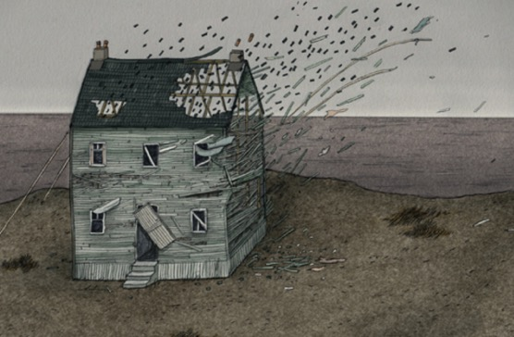
Test Your House Time!
Did your house withstand the wind test?
Did your house withstand the hail test?
Did your house withstand the rain test?
https://littlezosienka.wordpress.com/tag/lizzy-stewart/
Notes:
Each team tests their prototype while other teams observe.

Slide 22
Share!
In one-sentence, summarize the book:
If I Built a House
Notes:
Ask the students to quietly think about one sentence that will summarize the book “If I Built a House”.
Give students time to share their summary sentence.

Slide 23
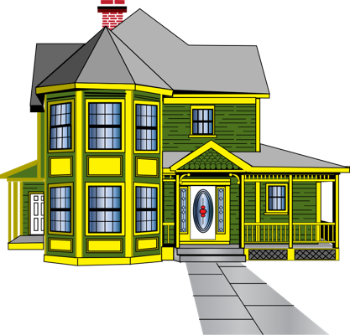
Journal Time
What would your dream house look like?

Slide 24
Improve Your House
Discuss with your team:
How can you improve your house?
Engineering Design Process
Notes:
Ask the students to notice that the word Improve is in one of the circles of the “Engineering Design Process”.
Students should discuss how they can Improve their house.
Students can use a teammates’ ideas or a combination of the teams’ ideas, but remind them that they must create one house together as a team!
Students should draw a picture or write a description of their house on their STEM Challenge handout.

Slide 25
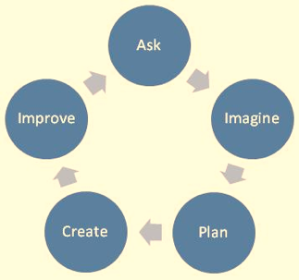
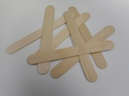
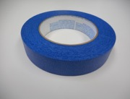
What materials do you, as a team, want to purchase to build your house?
Cards Straws Craft Play-Doh Tape Glue
Sticks
Notes:
Give the students the If I Built a House: Buying Time! handout. Give the students $4.00.
Walk around the room as the students work on the materials they would like to purchase.
Once a team is ready to purchase their materials, have them tell you the cost of the materials they would like to purchase and the change they should receive.

Slide 26
Building!
Build a house to withstand the forces of wind, rain, and hail.
Use only the materials you purchased.
Build a house in the given time.
Build a house on wax paper.
Build a house with a length, width, and height less than 6 inches.
Build a house with both walls and a roof.
Image from Building a House by Bryon Barton
http://www.troymessenger.com/2017/05/16/women-build-women-work-on-habitat-house/
http://www.alamy.com/stock-photo-kenya-marsabit-district-marsabit-borana-women-building-a-house-with-87407972.html
Notes:
Instruct students to build their houses on the wax paper.
As the students are building their prototypes, walk around the room and ask them probing questions about their design. For example:
What are your reasons for selecting that material?
What are your reasons for using that material for a wall?
What are your reasons for using that material for a roof?
*Note: It is most likely that the house built out of cards will be the best design. The Play-Doh is best used when packed in the bottom of the houses as a foundation to the structure.

Slide 27
Measuring Time!
What is the length of your house?
What is the width of your house?
What is the height of your house?
Notes:
Ask the students to share their ideas about what they consider to be the length, width, and height of their house.
If needed, have a class discussion about the meaning of length, width, and height.
Ask the students to measure the length, width, and height of their house.

Slide 28
Test Your House!
Did your house withstand the wind test?
Did your house withstand the hail test?
Did your house withstand the rain test?
https://littlezosienka.wordpress.com/tag/lizzy-stewart/
Notes:
Each team tests their prototype while other teams observe.

Slide 29
Design Reflection
What went well? Not so well? Why?
What aspects of other team designs stood out to you?
Did other designs give you ideas for ways to improve your design?
What modifications would you make if we had time to complete the design challenge again?
How did the materials affect the ability for the houses to withstand the forces applied to them?
Notes:
Facilitate a whole group reflection on final prototype design and testing results by asking questions such as the following.
What do you like best about your design?
What do you like least about your design?
What aspects of other team designs stood out to you, and/or gave you ideas for improving your own team’s design?
What modifications would you make if we had time to complete the design challenge again?
How did the materials affect the ability for the houses to withstand the forces applied to them?

Slide 30
Wrap Up
What ideas do you have for engineering a better world?
How can you turn ideas into reality?
Notes:
Conclude by discussing the following questions as post-activity surveys are distributed.
What ideas do you have for engineering a better world?
How can you turn ideas into reality?

Slide 31
MAKE A DIFFERENCE
This material is based upon work supported by:
the National Science Foundation under Grant No. EEC – 1009607
EiF grant 14.06
Engineering Science Foundation of Dayton under Grant No. AD2018-0001
2017-18 grant from the Marianist Foundation.
References:
Smooth Operator Presentation by Margaret Pinnell
This work is sponsored in part by the Engineering Information Foundation Grant EiF14.06 and the National Science Foundation Grant under Grant No EEC-1009607
Engineering for the Three Little Pigs
http://teachers.egfi-k12.org/3-little-pigs/
Ohio's new learning standards. Ohio department of education. 08 Aug 2014. Retrieved from: http://education.ohio.gov/Topics/Ohio-s-New-Learning-Standards/Ohios-New-Learning-Standards
www.discovere.org
Notes:
Allow time for students to complete their post-activity survey.

