Slide 1
TURNING IDEAS INTO REALITY: ENGINEERING A BETTER WORLD
Save Max!
www.discovere.org
Notes:
As the pre-activity survey is distributed to students, introduce yourself and provide enough of an activity overview to gain students excitement.
Allow time for students to individually complete their pre-activity survey.
Divide group into teams of 2 to 4 students (preferably 3 is possible).

Slide 2
What does an engineer do?
Solve problems and shape the future!
Create and design new “things” essential to health, happiness and safety:
Chemical things – food, medicine, shampoo, fuels…
Building things – bridges, skyscrapers, roads…
Technology things – iPods, Cameras, electronic gadgets…
Fun things – toys, roller coasters, sporting goods...
Important things – water systems, medical devices and tools…
Much, much more….the list is endless
images.businessweek.com
www.wistatefair.com
www.gettyimages.com
Notes:
Discuss engineering and what engineers do.

Slide 3
How do engineers do this?
Help others by solving all sorts of problems.
Use one of their most important tools: Their own creativity.
Work in design teams.
Use cool tools such as computers, microscopes, testing machines, etc.
Communicate with lots of people about problems they need solved.
Share ideas and solutions with others through presentations and/or writing.
www.engineeringmessages.org
Notes:
Do all engineers do the same thing?
NO, NO, NO!!!!!
Many types of engineers
Chemical
Mechanical
Electrical
Civil
They do many different types of jobs
Design
Sale
Test
Much, much more!

Slide 4
Today you will be a mechanical engineer – You will design, build and test a life vest!
Engineering a Better World
Max is the family dog and fell into the water. He doesn’t know how to swim, so you need to create a life vest to save him if he falls overboard!
Notes:
Present the engineering design problem and challenge, following presentation:
Explain that students will be taking on the role of mechanical engineers as they complete the engineering design challenge.

Slide 5
Engineering Design Problem
You are on a vacation at your friend’s lake house. You and your friend’s family decide take Max, the family dog, and go out on the lake for a boat trip.
While out on the boat, the water becomes rough and Max falls overboard into the water.
Since Max is still a puppy, he does not know how to swim yet.
Notes:
Present the real-world engineering design problem (scenario).

Slide 6
Engineering Design Challenge
Your team’s challenge is to use supplies that are on the boat to create a life vest that will keep Max afloat.
Remember, Max has already fallen overboard, so the life vest must be put on quickly to save him.
Notes:
Introduce the Engineering Design Challenge.

Slide 7
Design Goals
Device must be in one attached piece
Able to be affixed to the can within a 20 second period
Some portion of the can must touch the water and get wet. (Some portion of the can must also be above water)
You cannot just create a boat!
Have fun!!
Notes:
Share Engineering Design Goals.

Slide 8
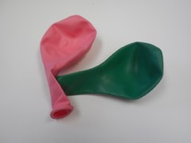
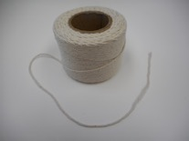
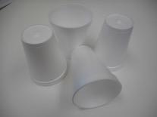
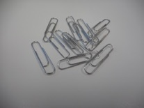
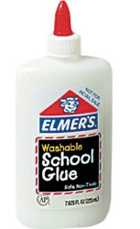
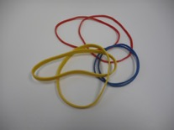
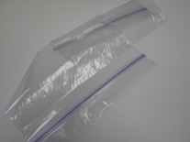
Materials
1
1 ft
1
4
3
2
1
Notes:
Introduce resources (materials) available to each team.
Materials consist of: balloons, string, rubber bands, cups, paperclips, glue, and ziplock bags

Slide 9
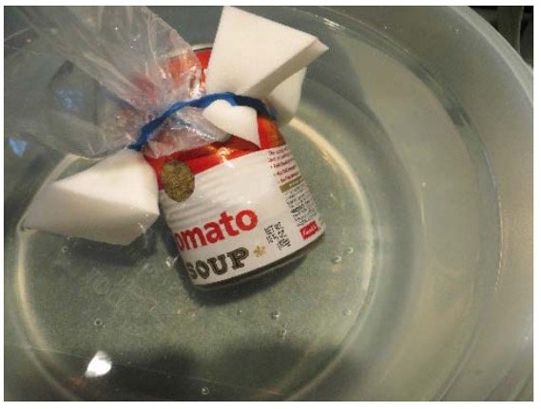
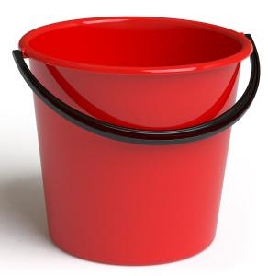
Design Testing
Notes:
Explain prototype-testing procedures.
The design is tested by attaching the design to a soup can within 20 seconds. After attaching, the can with the design is placed into the bucket of water (as indicated in the setup). The design passes if the can remains above water and floats for more than 20 seconds (This time can be adjusted depending on the amount of time left for the activity). Otherwise, the design needs to be changed so that the can would remain afloat

Slide 10
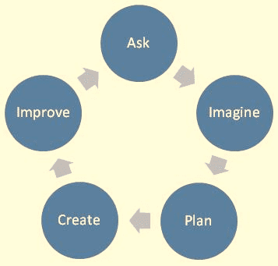
Engineering Design Process
ASK: What is the problem? How have others approached it? What are your constraints?
IMAGINE: What are some solutions? Brainstorm ideas. Choose the best one.
PLAN: Draw a diagram. Make lists of materials you will need.
CREATE: Follow your plan and create something. Test it out!
IMPROVE: What works? What doesn't? What could work better? Modify your designs to make it better. Test it out!
www.teachengineering.org
Notes:
Introduce the Engineering Design Process. Explain that engineers use it as a tool to help them more effectively solve problems.

Slide 11
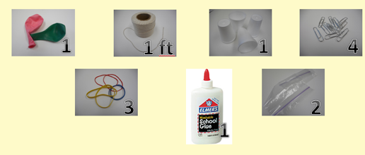
Engineering Design Process
Imagine (10 min.)
INDIVIDUALLY: Observe available materials, and brainstorm and write design ideas (5 min.)
TEAM: Share individual ideas (5 min.)
Plan (5 min.)
Choose and sketch a team design plan
Create (10 min.)
Gather materials
Construct your team design plan
Improve and Test (10 min.)
Notes:
Explain how teams will use the engineering design process as they complete the challenge.
Imagine (10 min.)
INDIVIDUALLY: observe available materials, and brainstorm and write design ideas (5 min.)
TEAM: share individual ideas (5 min.)
Plan (5 min.)
Choose and sketch a team design plan
Create (10 min.)
Gather materials
Construct your team design plan
Improve and Test (10 min.)
Teams decide on and make any last minute improvements before testing
Each team tests their prototype while other teams observe.

Slide 12
Design Reflection
What went well? Not so well? Why?
What aspects of other team designs stood out to you?
Did other designs give you ideas for ways to improve your design?
What modifications would you make if we had time to complete the design challenge again?
What was special properties of the materials you used in your design helped it be able to float?
Notes:
Facilitate a whole group reflection on final prototype design and testing results by asking questions such as the following.
What do you like best about your design?
What do you like least about your design?
What aspects of other team designs stood out to you, and/or gave you ideas for improving your own team’s design?
What modifications would you make if we had time to complete the design challenge again?
What was special properties of the materials you used in your design helped it be able to float?

Slide 13
Wrap Up
What ideas do you have for engineering a better world?
How can you turn ideas into reality?
Notes:
Conclude by cleaning up and discussing the following questions as post-activity surveys are distributed.
What ideas do you have for engineering a better world?
How can you turn ideas into reality?

Slide 14
This material is based upon work supported by:
the National Science Foundation under Grant No. EEC – 1009607
EiF grant 14.06
Engineering Science Foundation of Dayton under Grant No. AD2018-0001
2017-18 grant from the Marianist Foundation.
References:
Life vest challenge. (n.d.). Tryengineering.com. Developed by IEEE as part of TryEngineering. Retrieved from: http://www.tryengineering.org/lessons/lifevest.
Ohio's new learning standards. Ohio department of education. 08 Aug 2014. Retrieved from: http://education.ohio.gov/Topics/Ohio-s-New-Learning-Standards/Ohios-New-Learning-Standards.
www.discovere.org
Notes:
Allow time for students to complete their post-activity survey.

