Slide 1
TURNING IDEAS INTO REALITY: ENGINEERING A BETTER WORLD
Marble Ramp Kit
www.discovere.org
This material is based upon work supported by the Engineering Science Foundation of Dayton under
Grant No. AD2018-0001 and through a 2017-18 grant from the Marianist Foundation.
Notes:
As the pre-activity survey is distributed to students, introduce yourself and provide enough of an activity overview to gain students excitement.
Allow time for students to individually complete their pre-activity survey.
Divide group into teams of 4 or 5 students each.

Slide 2
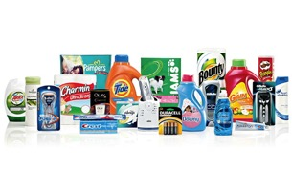
What does an engineer do?
Solve problems and shape the future!
Create and design new “things” essential to health, happiness and safety:
Chemical things – food, medicine, shampoo, fuels…
Building things – bridges, skyscrapers, roads…
Technology things – iPods, Cameras, electronic gadgets…
Fun things – toys, roller coasters, sporting goods...
Important things – water systems, medical devices and tools…
Much, much more….the list is endless
images.businessweek.com
www.wistatefair.com
www.gettyimages.com
This material is based upon work supported by the Engineering Science Foundation of Dayton under
Grant No. AD2018-0001 and through a 2017-18 grant from the Marianist Foundation.
Notes:
Discuss engineering and what engineers do.

Slide 3
How do engineers do this?
Help others by solving all sorts of problems.
Use one of their most important tools: Their own creativity.
Work in design teams.
Use cool tools such as computers, microscopes, testing machines, etc.
Communicate with lots of people about problems they need solved.
Share ideas and solutions with others through presentations and/or writing.
www.engineeringmessages.org
This material is based upon work supported by the Engineering Science Foundation of Dayton under
Grant No. AD2018-0001 and through a 2017-18 grant from the Marianist Foundation.
Notes:
Do all engineers do the same thing?
NO, NO, NO!!!!!
Many types of engineers
Chemical
Mechanical
Electrical
Civil
They do many different types of jobs
Design
Sale
Test
Much, much more!

Slide 4
Today you will be a civil engineer – You will design, build and test a luggage ramp!!!!
Engineering a Better World
https://www.youtube.com/watch?v=c-5Zoj7llM0
This material is based upon work supported by the Engineering Science Foundation of Dayton under
Grant No. AD2018-0001 and through a 2017-18 grant from the Marianist Foundation.
Notes:
Present the engineering design problem and challenge, following the presentation:
Show “Where does a bag go after it's checked? - Behind the Scenes @American Air” video (2m58s).

Slide 5
Engineering Design Problem
You work as a line crewmember (a person that loads and unloads luggage) for an airline company.
Because unloading luggage from an airplane by hand is time consuming and inefficient, you decide to try and come up with a better luggage transport system.
This material is based upon work supported by the Engineering Science Foundation of Dayton under
Grant No. AD2018-0001 and through a 2017-18 grant from the Marianist Foundation.
Notes:
Present the real-world engineering design problem.

Slide 6
Engineering Design Challenge
Your challenge is to design a more efficient system for transporting luggage straight from the airplane to the conveyor belt where passengers pick up their belongings.
Your design must transfer marbles from an elevated cup (airplane) to a cup on a lower level (baggage claim area).
This material is based upon work supported by the Engineering Science Foundation of Dayton under
Grant No. AD2018-0001 and through a 2017-18 grant from the Marianist Foundation.
Notes:
Introduce the Engineering Design Challenge.

Slide 7
Design Goals
Design and build a ramp to move the marbles from the top cup (airplane) to the bottom cup (luggage rack).
Use only materials provided.
Don’t let marbles fall off of your design.
Transport all the marbles.
Have fun!!
This material is based upon work supported by the Engineering Science Foundation of Dayton under
Grant No. AD2018-0001 and through a 2017-18 grant from the Marianist Foundation.
Notes:
Discuss Engineering Design Goals.

Slide 8
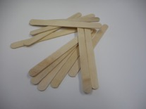
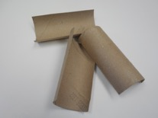
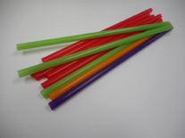
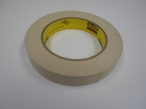
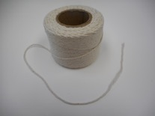
Materials
Materials Available to Build your Design
4
1
6
6 in
4
6
1 yd
This material is based upon work supported by the Engineering Science Foundation of Dayton under
Grant No. AD2018-0001 and through a 2017-18 grant from the Marianist Foundation.
Notes:
Introduce resources (materials) available to each team.
Quantities of each material are on slide. (popsicle sticks, toilet paper tubes, straws, tape, construction paper, notecards, and string)

Slide 9
Design Testing
One cup full of marbles will be elevated (airplane) and there will be another cup at a lower level (luggage rack).
You have to get the marbles from the top cup (airplane) to the bottom cup (luggage rack) using your design.
Each team may have 3 trials.
This material is based upon work supported by the Engineering Science Foundation of Dayton under
Grant No. AD2018-0001 and through a 2017-18 grant from the Marianist Foundation.
Notes:
Explain prototype-testing procedures.

Slide 10
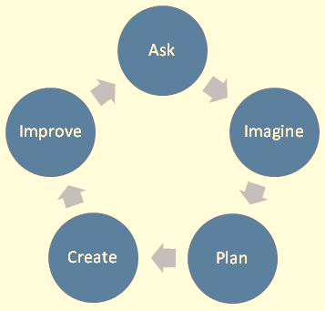
Engineering Design Process
ASK: What is the problem? How have others approached it? What are your constraints?
IMAGINE: What are some solutions? Brainstorm ideas. Choose the best one.
PLAN: Draw a diagram. Make lists of materials you will need.
CREATE: Follow your plan and create something. Test it out!
IMPROVE: What works? What doesn't? What could work better? Modify your designs to make it better. Test it out!
www.teachengineering.org
This material is based upon work supported by the Engineering Science Foundation of Dayton under
Grant No. AD2018-0001 and through a 2017-18 grant from the Marianist Foundation.
Notes:
Introduce the Engineering Design Process. Explain that engineers use it as a tool to help them more effectively solve problems.

Slide 11
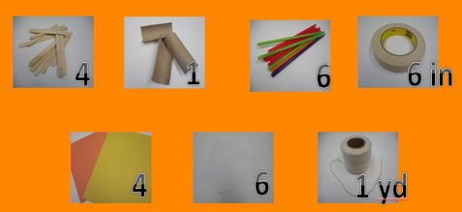
Engineering Design Process
Imagine (10 min.)
INDIVIDUALLY: Observe available materials, and brainstorm and write design ideas (5 min.)
TEAM: Share individual ideas (5 min.)
Plan (5 min.)
Choose and sketch a team design plan
Create (10 min.)
Gather materials
Construct your team design plan
Improve and Test (10 min.)
This material is based upon work supported by the Engineering Science Foundation of Dayton under
Grant No. AD2018-0001 and through a 2017-18 grant from the Marianist Foundation.
Notes:
Explain the working process: How teams will use the engineering design process as they complete the challenge:
Imagine (10 min.)
INDIVIDUALLY: observe available materials, and brainstorm and write design ideas (5 min.)
TEAM: share individual ideas (5 min.)
Plan (5 min.)
Choose and sketch a team design plan
Create (10 min.)
Gather materials
Construct your team design plan
Improve and Test (10 min.)
Teams decide on and make any last minute improvements before testing.
Make sure the marbles are being properly transferred from the top cup (airplane) to the bottom cup (luggage rack). Students get 3 trials to test their design.
Each team tests their prototype while other teams observe.

Slide 12
Design Reflection
What went well? Not so well? Why?
What aspects of other team designs stood out to you?
Did other designs give you ideas for ways to improve your design?
What modifications would you make if we had time to complete the design challenge again?
How did you use potential and kinetic energy in your design?
This material is based upon work supported by the Engineering Science Foundation of Dayton under
Grant No. AD2018-0001 and through a 2017-18 grant from the Marianist Foundation.
Notes:
Facilitate a whole group reflection on final prototype design and testing results by asking questions such as the following.
What do you like best about your design?
What do you like least about your design?
What aspects of other team designs stood out to you, and/or gave you ideas for improving your own team’s design?
What modifications would you make if we had time to complete the design challenge again?
How did you use potential and kinetic energy in your design?
How does their process relate their process to engineering process?

Slide 13
Wrap Up
What ideas do you have for engineering a better world?
How can you turn ideas into reality?
This material is based upon work supported by the Engineering Science Foundation of Dayton under
Grant No. AD2018-0001 and through a 2017-18 grant from the Marianist Foundation.
Notes:
Conclude by discussing the following questions as post-activity surveys are distributed.
What ideas do you have for engineering a better world?
How can you turn ideas into reality?

Slide 14
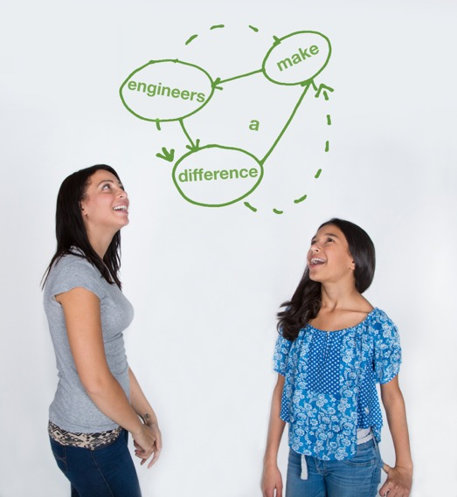
This material is based upon work supported by:
the National Science Foundation under Grant No. EEC – 1009607
EiF grant 14.06
Engineering Science Foundation of Dayton under Grant No. AD2018-0001
2017-18 grant from the Marianist Foundation.
References:
Ohio's new learning standards. Ohio department of education. 08 Aug 2014. Retrieved from: http://education.ohio.gov/Topics/Ohio-s-New-Learning-Standards/Ohios-New-Learning-Standards
Where does a bag go after it's checked? - behind the scenes @ AmericanAir. YouTube06 Jul 2012. Retrieved from: https://www.youtube.com/watch?v=c-5Zoj7llM0.
www.discovere.org
This material is based upon work supported by the Engineering Science Foundation of Dayton under
Grant No. AD2018-0001 and through a 2017-18 grant from the Marianist Foundation.
Notes:
Allow time for students to complete their post-activity survey.

