Slide 1
Iggy Peck Architect
“Using Engineering Design to Increase Literacy and STEM Interest Among Third Graders”
This material is based upon work supported by the Engineering Science Foundation of Dayton under Grant No. AD2018-0001 and through a 2017-18 grant from the Marianist Foundation.

Slide 2
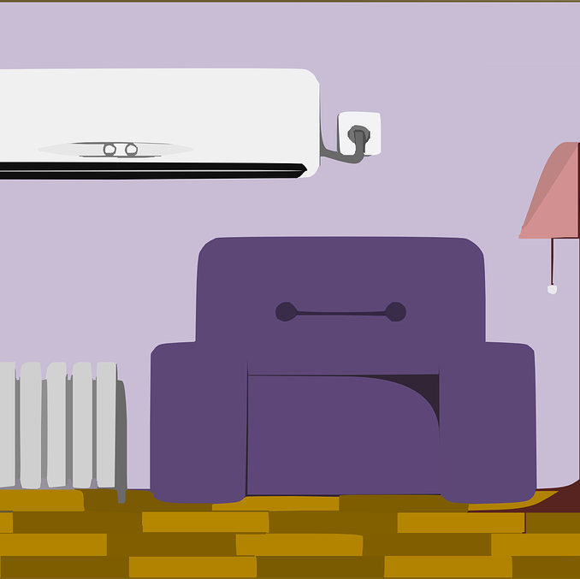
Day 1: Journal Entry
Describe your favorite room in your house.
What do you call this room?
What does the room look like?
What makes this room cosy?
What makes this room fun?
What is your favorite thing to do in this room?
www.clipartsuggest.com

Slide 3
6 Rules of STEM
Be nice to everyone.
Use a normal speaking level (do not yell).
Be quiet while others are talking.
Keep your hands and feet to yourself.
Come to STEM and have fun every time.
Respect each other.
Our class goal is: to be nice to each other everyday

Slide 4
Define Architect
An architect is…..
a person who designs buildings and in many cases also supervises their construction.

Slide 5
Engineering Design Problem and Challenge
Problem:
Last week we built bridges following the directions from K'nex kits that would allow people to cross a river. This week you are an architect, just like Iggy Peck, and you have been commissioned to design a bridge that will cross an even wider river.
Challenge:
Your team’s challenge is to design then create a prototype of a bridge that people and cars could use cross the wide river.
www.goodreads.com

Slide 6
Design Goals
Design a bridge using K’Nex Education- Introduction to Structures: Bridges.
The bridge must be 8 panels long.
The bridge should hold the most weight possible.

Slide 7
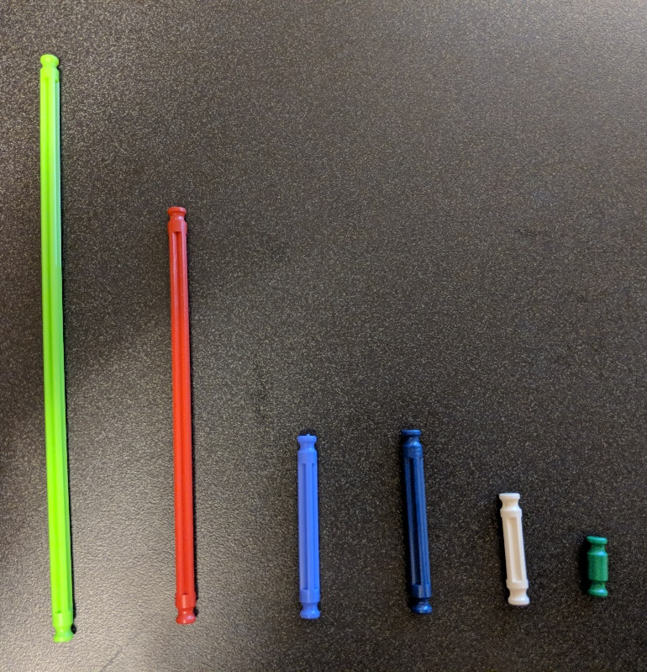
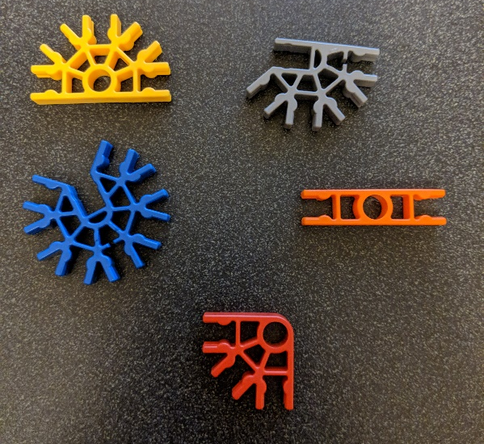
Resources
K’Nex Education- Introduction to Structures: Bridge Pieces
Panels
Rods
Connectors

Slide 8
Design Testing Procedures
Prepare
Move two tables about 20 inches apart and place the bridge on top of the tables to connect them.
Make sure nothing is underneath the bridge or tables.
Test
Add testing masses to the top of the bridge until it collapses or is no longer safe to use.
Record how much mass the bridge held.
Reflect
Think about what part of the bridge broke.
Discuss how the bridge can be improved.
Redesign
Use what you learned from testing to improve the bridge.
Retest to see if the improvements worked.

Slide 9
The Engineering Design Process
ASK: What is the problem? How have others approached it? What are your constraints?
IMAGINE: What are some solutions? Brainstorm ideas. Choose the best one.
PLAN: Draw a diagram. Make lists of materials you will need.
CREATE: Follow your plan and create something. Test it out!
IMPROVE: What works? What doesn't? What could work better? Modify your designs to make it better. Test it out!
www.teachengineering.org
Ask
Improve
Imagine
Create
Plan

Slide 10
Ask
What do you need to change to make your bridge longer?
Will a longer bridge be weaker than a shorter bridge?
Do you need to change how the panels are supported?
Would the panels be supported differently if your bridge was not so high off of the ground?
www.clipartpost.com
www.clipartix.com

Slide 11
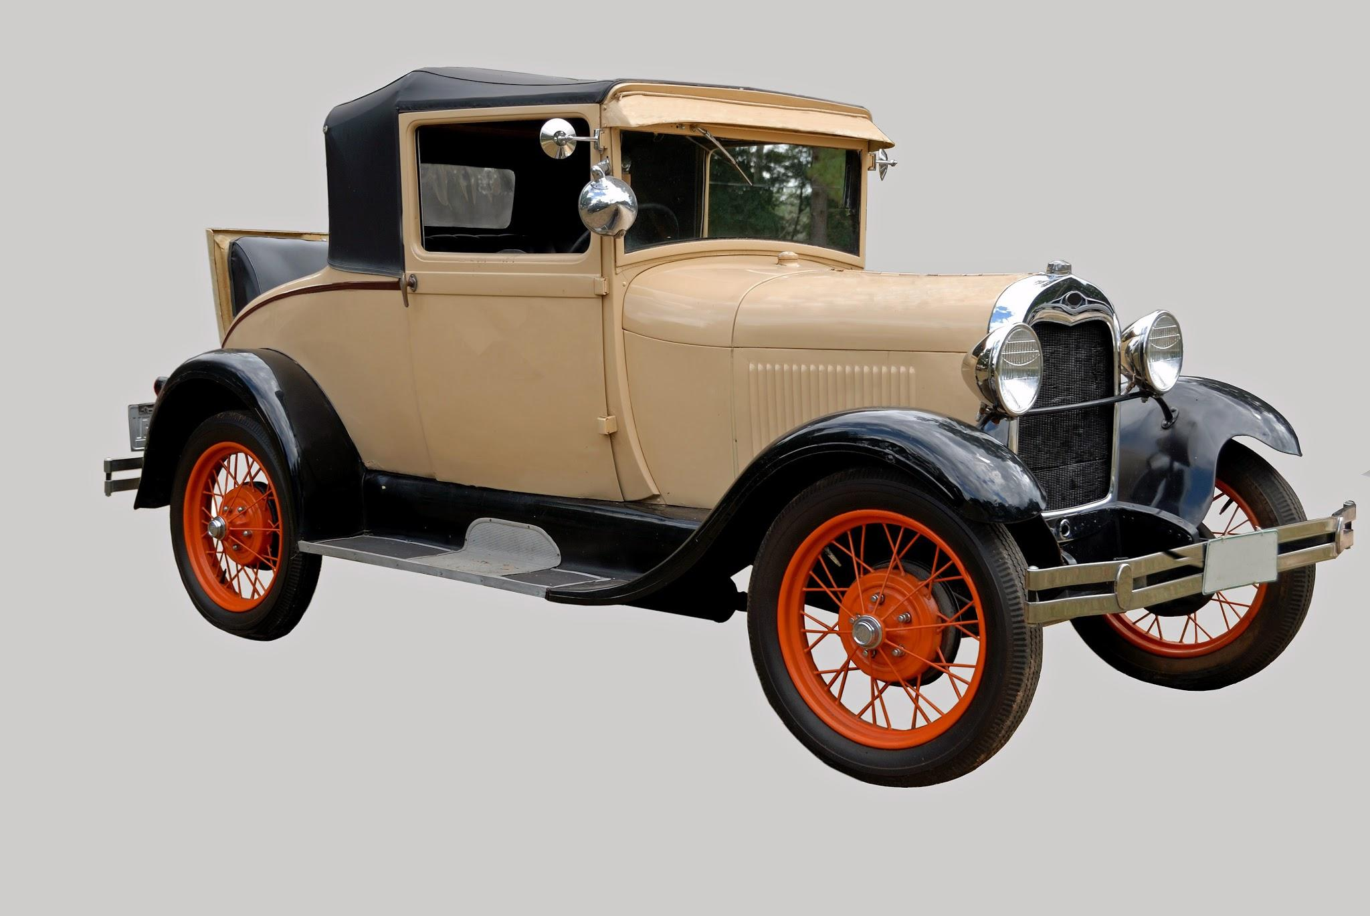
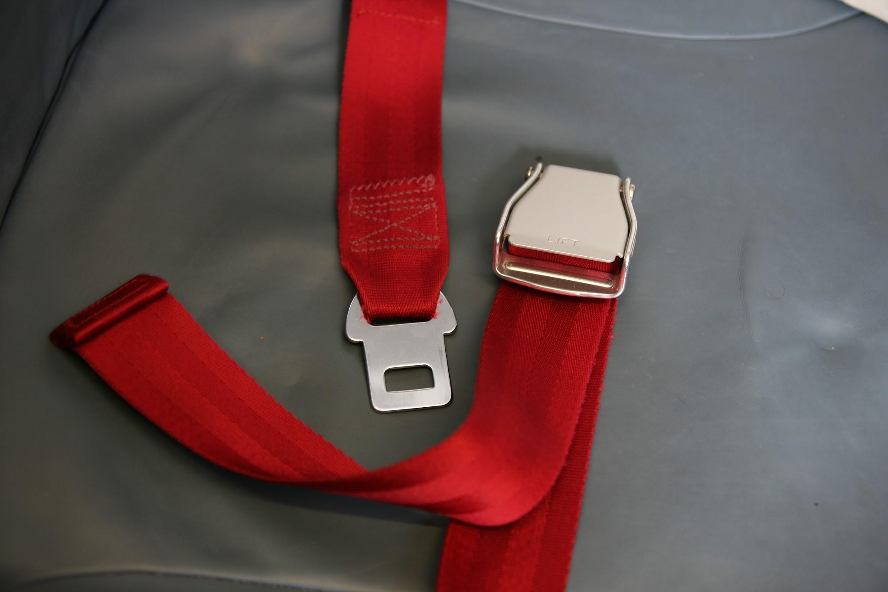
Day 2: Journal Prompt
Can you think of an invention that modern engineers have redesigned to make better?
What problems did they solve when they changed the invention?
Write about how you could change something you use every day to make it better.

Slide 12
Ask: How could you make your bridge longer?
Let’s learn more about how engineers redesign.
Discuss how you could improve your solution with your partner.
Make revisions.
Draw new designs.

Slide 13
Design Testing Procedures
Prepare
Move two tables about 20 inches apart and place the bridge on top of the tables to connect them.
Make sure nothing is underneath the bridge or tables.
Test
Add testing masses to the top of the bridge until it collapses or is no longer safe to use.
Record how much mass the bridge held.
Reflect
Think about what part of the bridge broke.
Discuss how the bridge can be improved.
Redesign
Use what you learned from testing to improve the bridge.
Retest to see if the improvements worked.

Slide 14
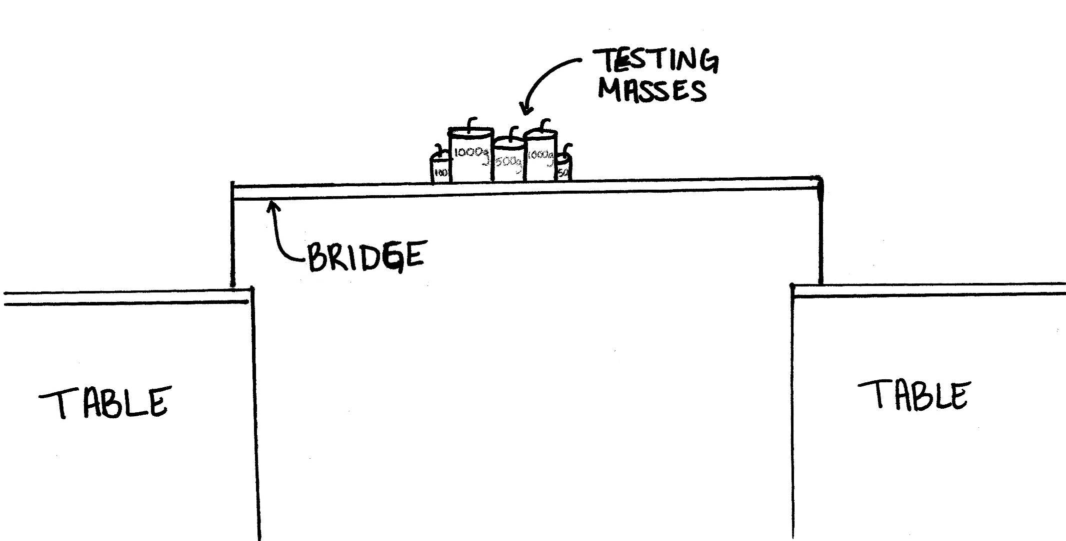
Bridge Testing Drawing Example

Slide 15
Counting Masses Example
Mass: | 1000 grams | 500 grams | 100 grams | 50 grams
Number of Masses the Bridge Held: | 2 | 1 | 1 | 1
Total Mass the Bridge Held: 2,650 grams

Slide 16
Concluding Questions
What ideas do you have for engineering a better world?
How can you turn ideas into reality?
www.goodreads.com

