Slide 1
TURNING IDEAS INTO REALITY: ENGINEERING A BETTER WORLD
Galimoto
www.discovere.org
Notes:
As the pre-activity survey is distributed to students, introduce yourself and provide enough of an activity overview to gain students excitement. Set up testing area with the pan and have materials for toothpaste ready and organized.
Allow time for students to individually complete their pre-activity survey.
Divide group into teams of 3 or 4 students.

Slide 2
Journal Entry:
If you could invent anything in the world what would it be?
I would invent…
I would invent this because...

Slide 3
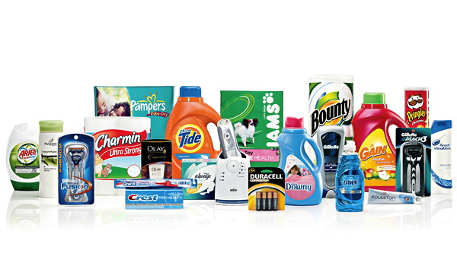
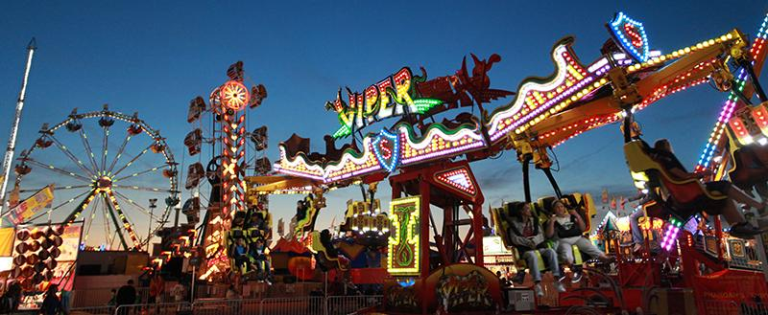
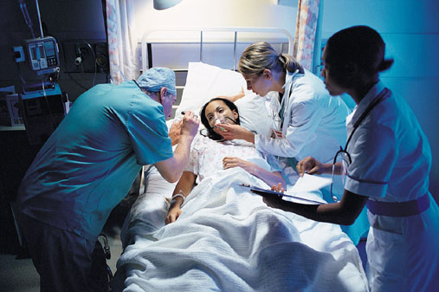
What does an engineer do?
Solve problems, and shape the future!
Create and design new “things” essential to health, happiness and safety:
Chemical things – food, medicine, shampoo, fuels…
Building things – bridges, skyscrapers, roads…
Technology things – iPods, Cameras, electronic gadgets…
Fun things – toys, roller coasters, sporting goods...
Important things – water systems, medical devices and tools…
Much, much more….the list is endless
images.businessweek.com
www.wistatefair.com
www.gettyimages.com
Notes:
Slides 2 and 3: Discuss engineering and what engineers do.

Slide 4
How do engineers do this?
Help others by solving all sorts of problems.
Use one of their most important tools: their own creativity.
Work in design teams.
Use cool tools such as computers, microscopes, testing machines, etc.
Communicate with lots of people about problems they need solved.
Share ideas and solutions with others through presentations and/or writing.
www.engineeringmessages.org
Notes:
Do all engineers do the same thing?
NO, NO, NO!!!!!
Many types of engineers
Chemical
Mechanical
Electrical
Civil
They do many different types of jobs
Design
Sale
Test
Much, much more!

Slide 5
6 rules of STEM
Be nice to everyone.
Use a normal speaking level (do not yell).
Be quiet while others are talking.
Keep your hands and feet to yourself.
Come to STEM and have fun every time.
Respect each other.
Our class goal is: To be nice to each other everyday

Slide 6
Questions for Dr. Eustice
What supplies did you use for your Galimoto?
Why did you want to build Galimoto’s?
Can you teach me how to build a Galimoto?
How is your house different here compared to your home in Tanzania?
Can you show us on the globe please
What was it like living in Africa?
Is the food different here compared to Africa?
What do they eat in Africa?

Slide 7
Questions for Dr. Eustice - Continued
Do people in Africa eat yogurt?
How old were you when you started building Galimotos?
Where did you get your supplies for a Galimoto?
Have you lived anywhere else?
Have you invented anything?
If not what would you want to invent
What is your best advice for a third grader?
What is the most important thing in life to you?
What makes you happy?

Slide 8
Engineering Design Problem
It’s summer vacation, and you are in charge of all the toys.
Your parents gave you and a couple friends the idea to create your own toy or game. They said if you create the best toy or game, that they will help you make more toys/games and sell them to your friends and neighbors.
Think like an engineer and design your dream toy/game.
Notes:
Slide 5: Present the real-world engineering design problem (scenario).

Slide 9
Today you will be a mechanical engineer
Engineering a Better World
You are being asked to create your own toy or game out of any recycled items you can find or bring in.
Examples:
tissue boxes
toilet paper rolls
egg containers
juice, milk, or pop container
plastic lids
anything that you and your family would consider as a recyclable :)
Notes:
Present the engineering design problem and challenge, following presentation:
Slide 4: Play video (1m 49s).

Slide 10
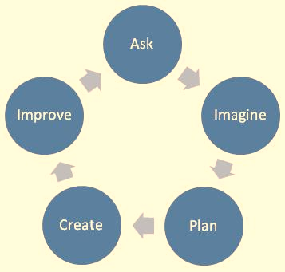
Engineering Design Challenge
Your team’s challenge is to design the best new toy!
Everything you use has to be a recycled item.
ASK: What is the problem? How have others approached it? What are your constraints?
IMAGINE: What are some solutions? Brainstorm ideas. Choose the best one.
PLAN: Draw a diagram. Make lists of materials you will need.
CREATE: Follow your plan and create something. Test it out!
IMPROVE: What works? What doesn't? What could work better? Modify your designs to make it better. Test it out!
www.teachengineering.org
Notes:
Slide 6: Introduce the Engineering Design Challenge.

Slide 11
Design Goals
Create your own toy or game using only recycled items.
Use your imagination to create a toy or game that has never been invented before.
Work as a group to create this toy.
Have fun!!
Notes:
Slide 7: Share Engineering Design Goals.

Slide 12
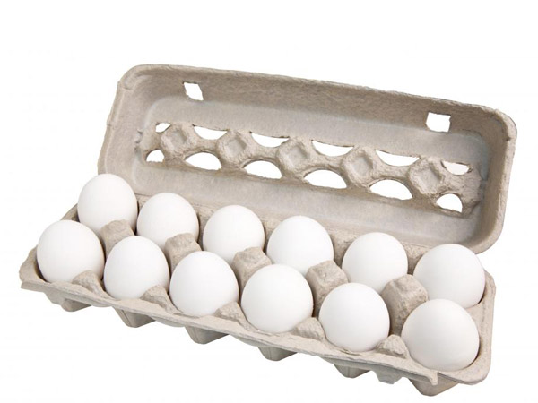
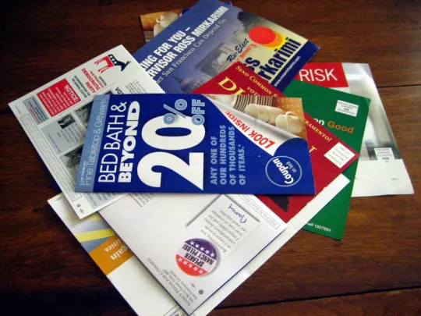
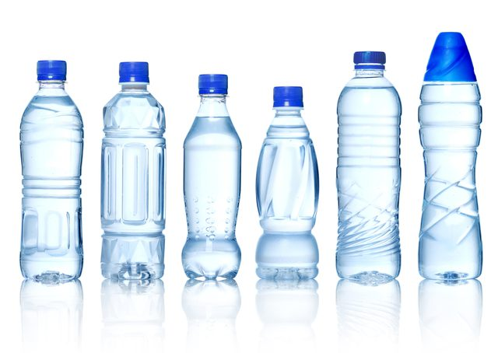
Materials
Any recycled materials you bring in
Masking tape
Glue
Scissors
Notes:
Slide 8: Introduce resources (materials) available to each team.
If constraining materials, each group can use-
Wooden Craft Sticks- 4
Masking Tape- 1 foot
Duct Tape- 4 inches
Straws- 8
Foam Plate- 1
Cardboard- 1
Foam Cup- ½
Crayola Modeling Clay- 1/8
Foil- 3 inches
Lego Blocks- 5
Toothpicks- 10

Slide 13
Design Testing
Present your toy or game to the class:
explain how you made it and
what you made it with.
Why you think your toy is the best?
Our toy is the best because…
Explain how you came up with the idea of this toy:
We wanted to make this type of toy because…
What would you do differently:
If we had more time we would...
Notes:
Explain how teams will work.
Slide 9: Explain prototype-testing procedures.

Slide 14
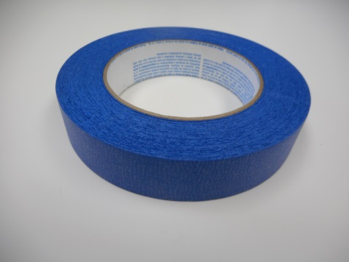
Engineering Design Process
Imagine (10 min.)
INDIVIDUALLY: observe available materials, and brainstorm and write design ideas (5 min.)
TEAM: share individual ideas (5 min.)
Plan (5 min.)
Choose and sketch a team design plan
Create (10 min.)
Gather materials
Construct your team design plan
Improve and Test (10 min.)
Notes:
Slide 11: Explain how teams will use the engineering design process as they complete the challenge.
Brainstorm:
Each individual in a team must write or sketch one or two ideas.
Team must discuss each idea.
Team decides criteria most important to them while keeping constraints (limited time and materials, etc.) in mind.
Create Team Prototype:
Teams choose, sketch, and outline their prototype design idea.
Teams have idea approved by facilitator.
Gather Materials:
Teams receive their bag of materials (prepared in advance).
Create Chosen Design:
Team creates their approved prototype design plan.
Final Test:
Each team tests their prototype while other teams observe.

Slide 15
Design Reflection
What went well? Not so well? Why?
What aspects of other team designs stood out to you?
Did other designs give you ideas for ways to improve your design?
What modifications would you make if we had time to complete the design challenge again?
Notes:
Slide 12: Facilitate a whole group reflection on final prototype design and testing results by asking questions such as the following.
What do you like best about your design?
What do you like least about your design?
What aspects of other team designs stood out to you, and/or gave you ideas for improving your own team’s design?
What modifications would you make if we had time to complete the design challenge again?

Slide 16
Wrap Up
What ideas do you have for engineering a better world?
How can you turn ideas into reality?
Notes:
Slide 13: Conclude by discussing the following questions as post-activity surveys are distributed.
What ideas do you have for engineering a better world?
How can you turn ideas into reality?

Slide 17
This material is based upon work supported by the National Science Foundation under Grant No. EEC – 1009607 and through EiF grant 14.06
References:
Ohio's new learning standards. Ohio department of education. 08 Aug 2014. Retrieved from: http://education.ohio.gov/Topics/Ohio-s-New-Learning-Standards/Ohios-New-Learning-Standards
www.discovere.org
Notes:
Allow time for students to complete their post-activity survey.

